Slide 1
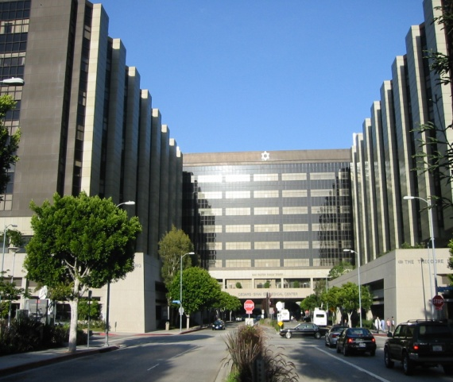
Machine learning improves image analysis, diagnosis and prognostic risk assessment in cardiac imaging: an update”
Some software described in this presentation is owned by Cedars-Sinai Medical Center, which receives or may receive royalties from its licensing. A minority portion of those royalties is shared by the authors
Piotr J. Slomka, PhD, FACC
Scientist , Artificial Intelligence in Medicine
Cedars Sinai Medical Center
Professor of Medicine, UCLA school of Medicine
Piotr.Slomka@cshs.org
Cedars-Sinai Medical Center

Slide 2
Machine learning
Predicitng anything that can be predicted
No particular model is assumed unlike in statistics
Testing data always separate from training data
AN UPDATE
Predicting death from CTA and clinical data EHJ 2016
Predicting MACE from fast MPS JACC Imaging 2017
Predicting cardiac/cardiovascular death from large registry
AHA 2017 (Nakanishi Slomka AHA 2017)
Deep learning SCCT, RSNA 2017
Predicting CAD by Deep learning from MPI images ASNC 2017
mage analysis

Slide 3
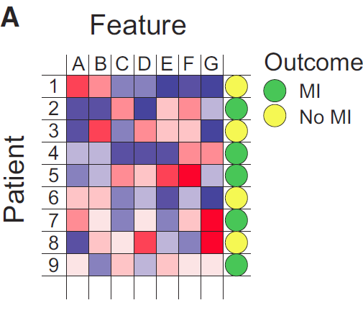
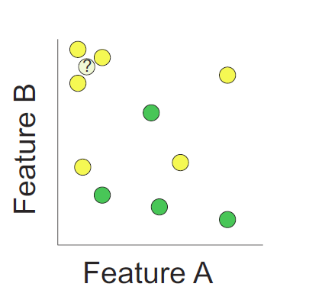
Simple machine learning
The k-nearest neighbor algorithm assigns outcome based on the most similar training examples
MI -myocardial infarction
Deo RC Circulation 2015

Slide 4
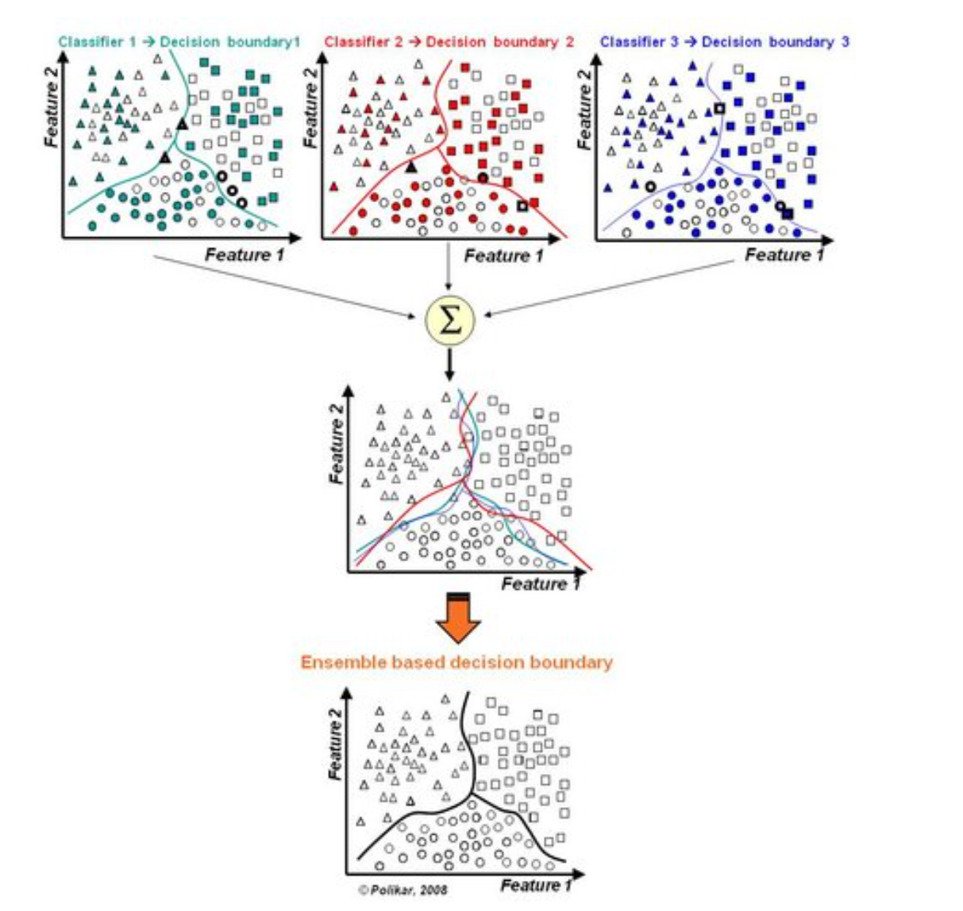
Ensemble (boosted) learning
Similar to
consensus
human
reading
http://magizbox.com

Slide 5
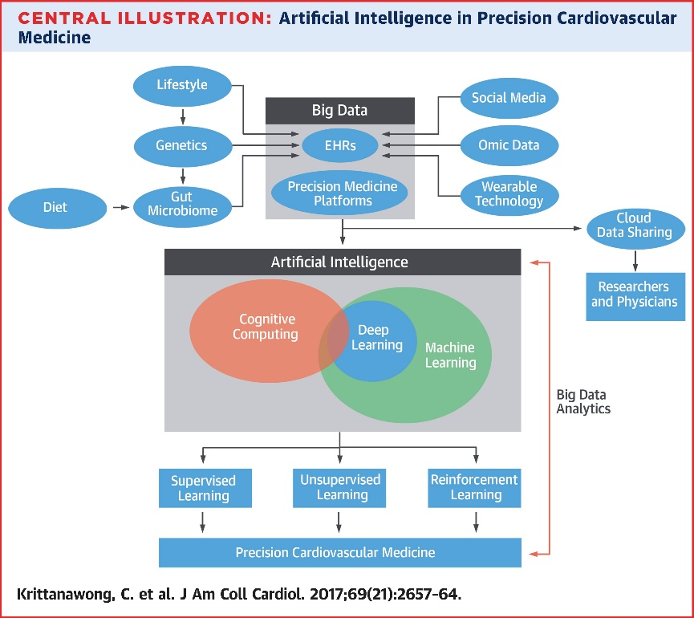
Machine learning discussed for emerging AI tools for cardiovascular medicine
may play an important role in emerging artificial intelligence tools for cardiovascular medicine
Source: NVIDIA
DL for unsupervised US
DL for precision cardiology
DL others …
Notes:
(Use Image NVIDIA)
Deep learning is a machine learning tool, proposed in the 90s but with breakthrough application in machine vision in the last years given the advance in hardware computational power (GPUs) and the availability of big amounts of data
Quote editorials in JACCimaging
They apply now in MR (Kaggle)
Now we apply here…
It has been hypothesized that the ability of deep learning to quantify relevant measurements from the raw image data itself will play an important role in cardiovascular medicine e.g. in precision cardiology (15) or as DL unsupervised feature for echocardiography imaging (8,16,17). In our study, we show that DL has the ability to enhance already highly-refined automatic quantification of MPI by direct analysis of polar map image data. We could leverage in our study the availability of large heterogenous population from multiple sites in our registry. We also could leverage the capabilities of the conventional software to transform raw 3D MPI images to simpler low-dimension polar maps, which nevertheless retain key perfusion information. Perhaps a similar approach could be also investigated in other imaging modalities. In the future, the direct diagnosis form raw 3D images by deep learning could be also possible but may require much larger sample sizes and could be more demanding for the DL architecture.

Slide 6
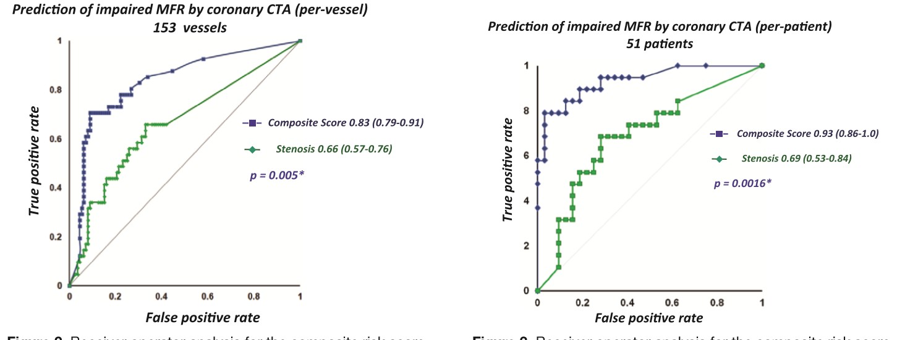
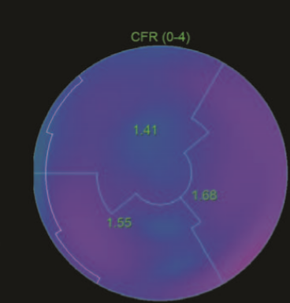
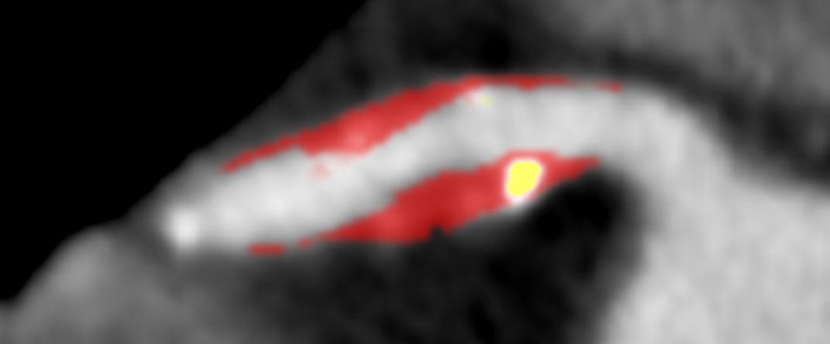
CTA quantification predicts myocardial flow reserve by ¹³NH3 PET
CTA automatic plaque characteristics( 5 features), myo mass, age/gender
LogitBoost ensemble learning 10-fold cross validation per-vessel per-patient
Machine learning
AUC=Area under curve
*p < 0.05 vs. PET alone
Dey et al Circ Cardiovasc Imaging 2015

Slide 7
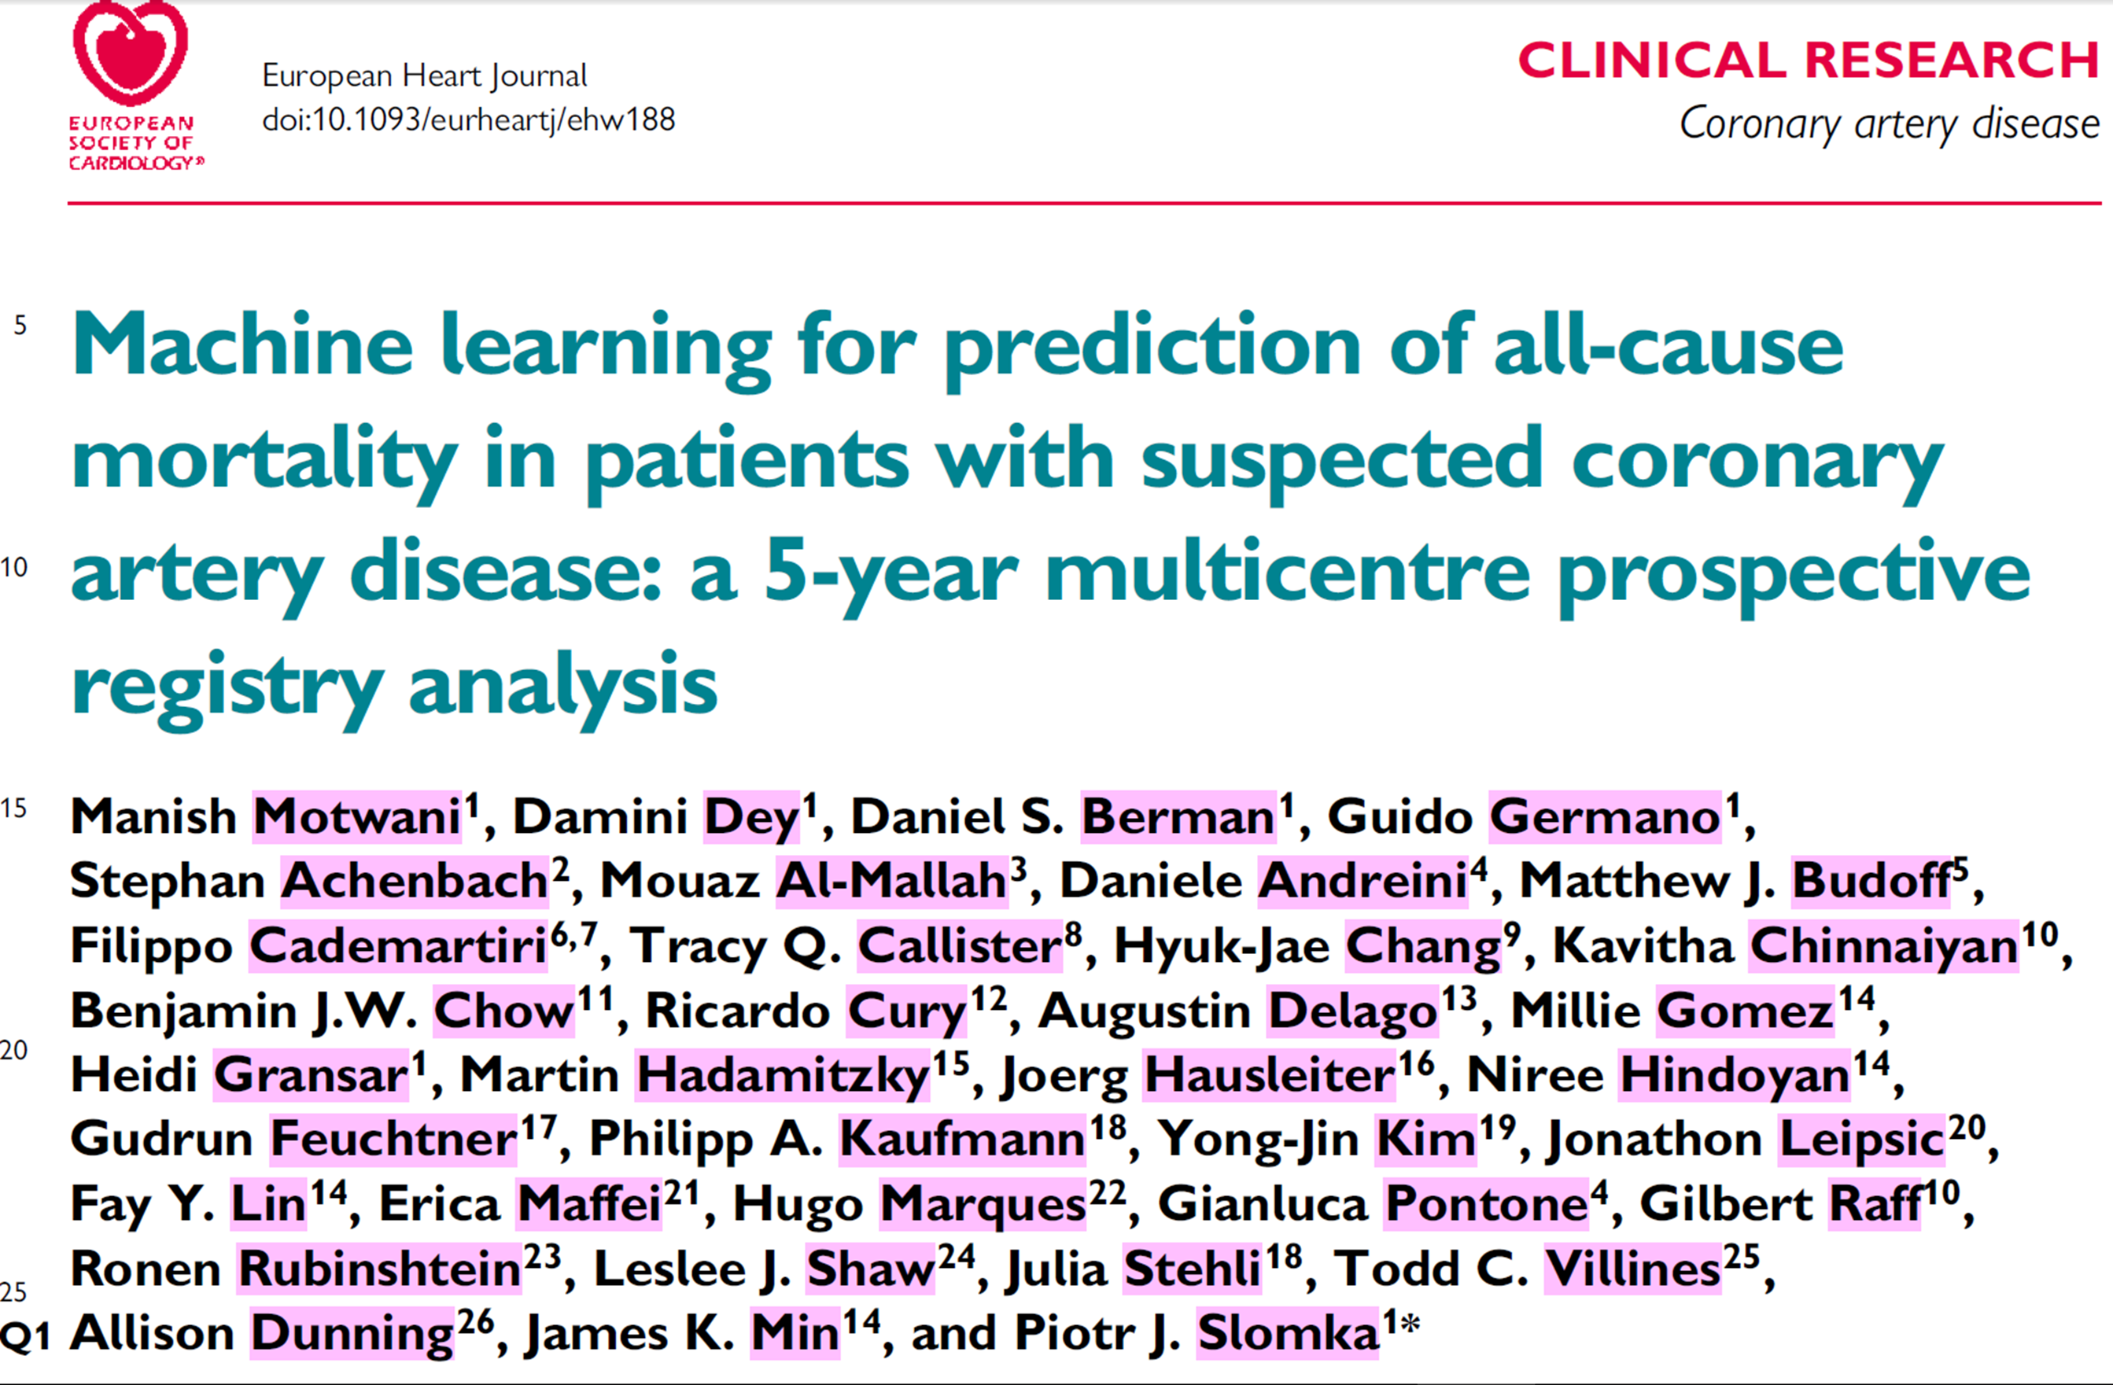
Motwani M, EHJ 2016

Slide 8
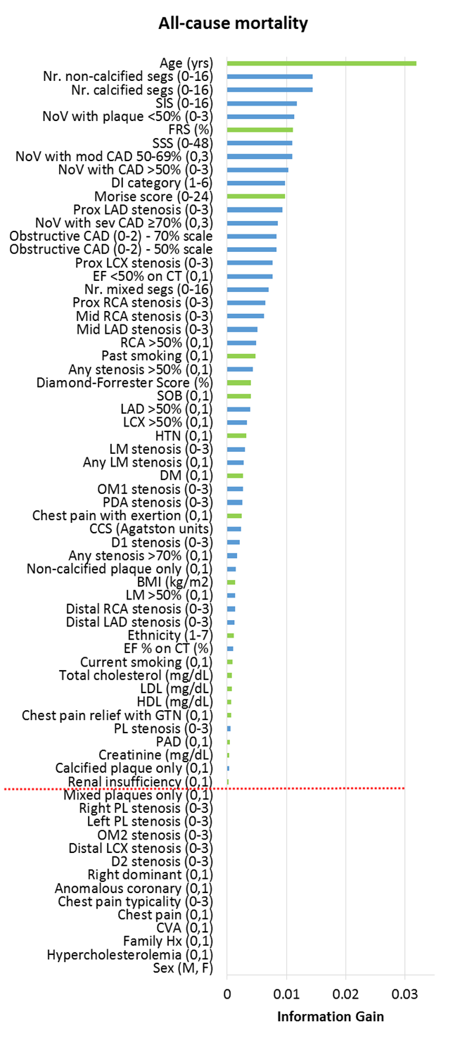
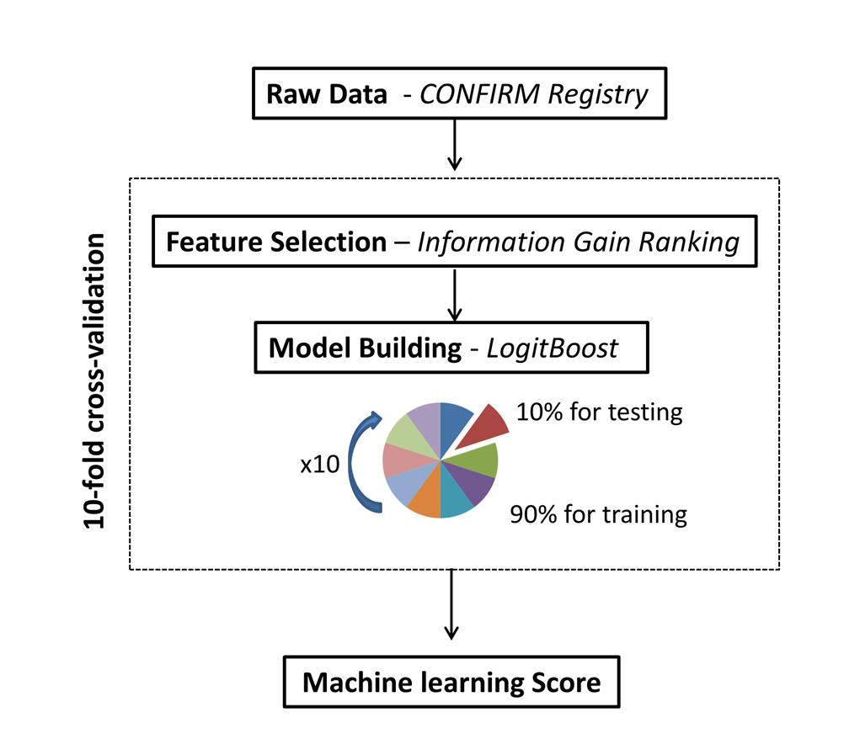
Feature selection and learning
(ensemble
Motwani M et al EHJ 2016

Slide 9
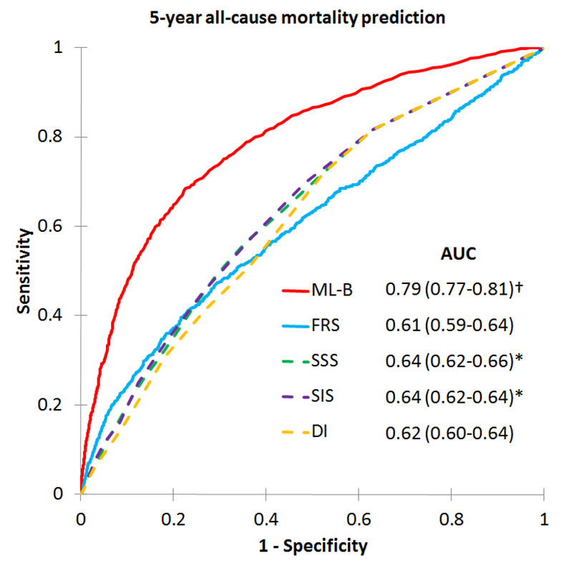
Death prediction by ensemble machine learning over standard risk scores
ML-B -boosted machine learning
FRS –Framingham risk score
SSS –segmental stenosis score
SIS –segmental involvement score
DI -Duke index
AUC –area under curve
N=10,030
Motwani M et al, EHJ 2016

Slide 10
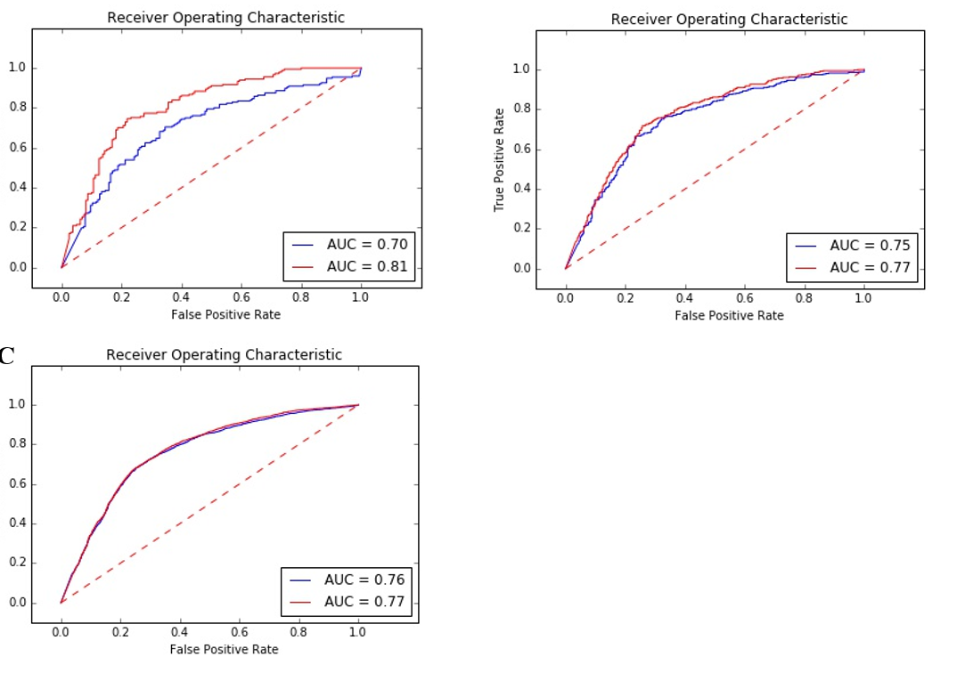
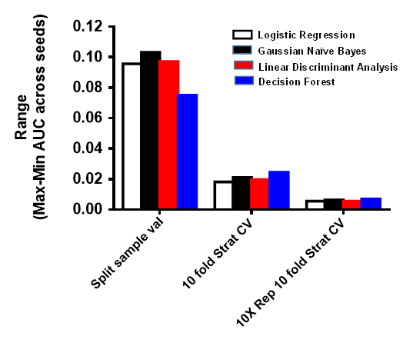
Uncertainty of validation 10-fold cross-validation (CV) versus traditional (in medicine) split sample training/testing
Split sample
10-fold CV
One arbitrary split sample division
Average of 10 split sample divisions
min/max
min/max
Repeated 10-fold CV
N=700 100 random data split simulations with 4 ML algorithms
Average of 100 split sample divisions
min/max
Singh et al (in preparation)

Slide 11
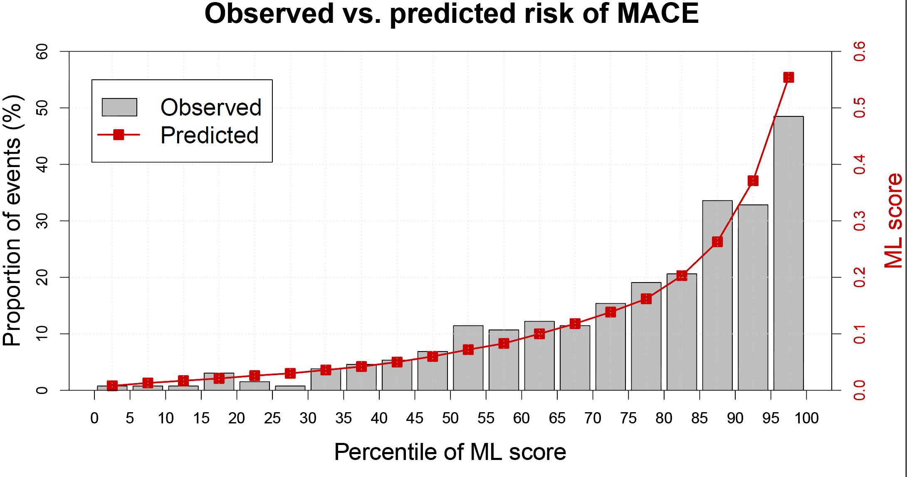
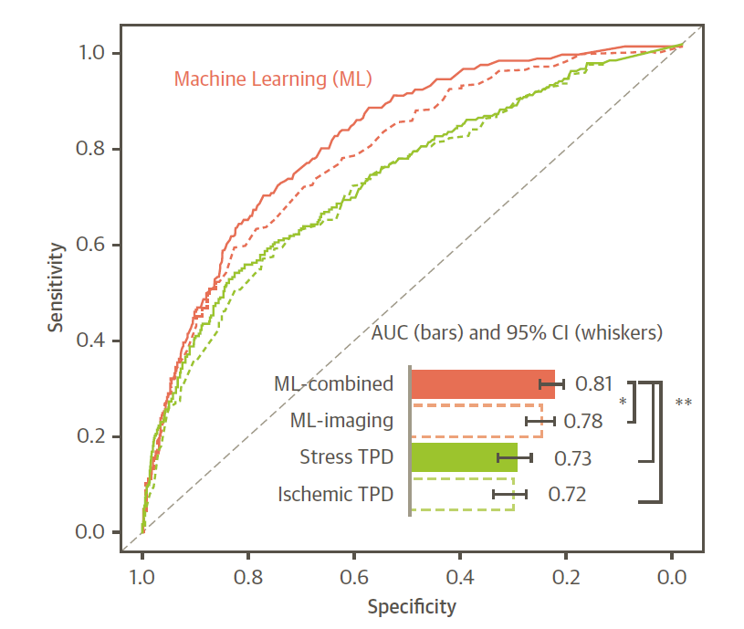
Prediction of 3-year MACE by MPI and machine learning
N=2619 fast MPI scans
ML score ≥0.15
N= 625
N= 653
Stress TPD≥ 4 %
SSS ≥1
N= 1965
N=1993
Machine learning for automated prediction of
major adverse coronary events after myocardial
perfusion imaging Betancur et al JACC Img 2017
SSS= 0
N= 1956
Stress TPD< 4 %
ML machine learning
MACE –major adverse cardiovascular events
TPD –total perfusion deficit
SSS/SDS –visual summed stress/difference score
Notes:
SSS1, stress TPD, Machine learning score0.15 is 75 to 80 percentile for our population. Frequency of MACE in 80 percentile visual automated and machine learning scores. Compared to the visual and automated assessment, Machine learning has 1.2 to 13 times higher frequency of MACE.

Slide 12
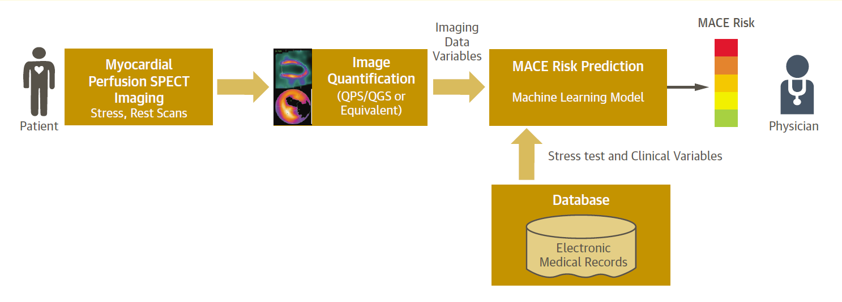
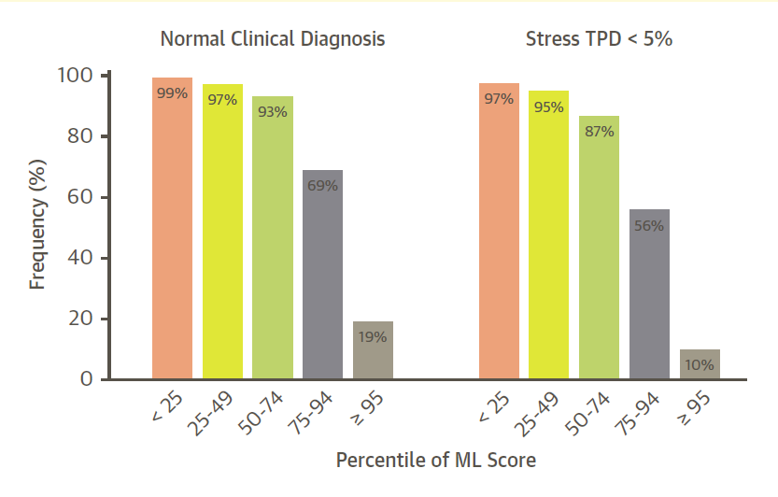
MACE by MPI and machine learning
How to use it clinically ?
Betancur et al JACC Cardiovascular Imaging 2017

Slide 13
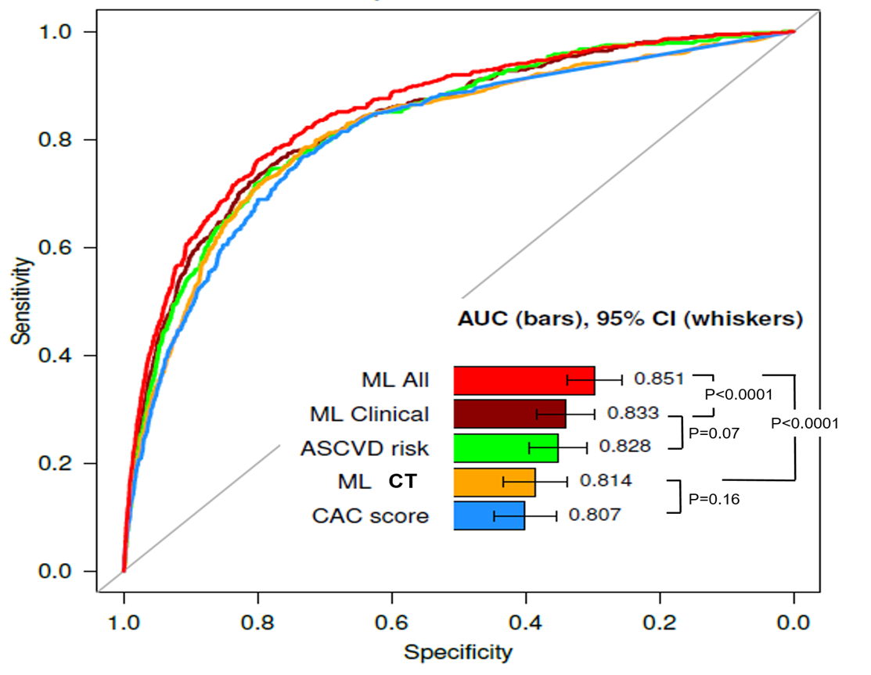
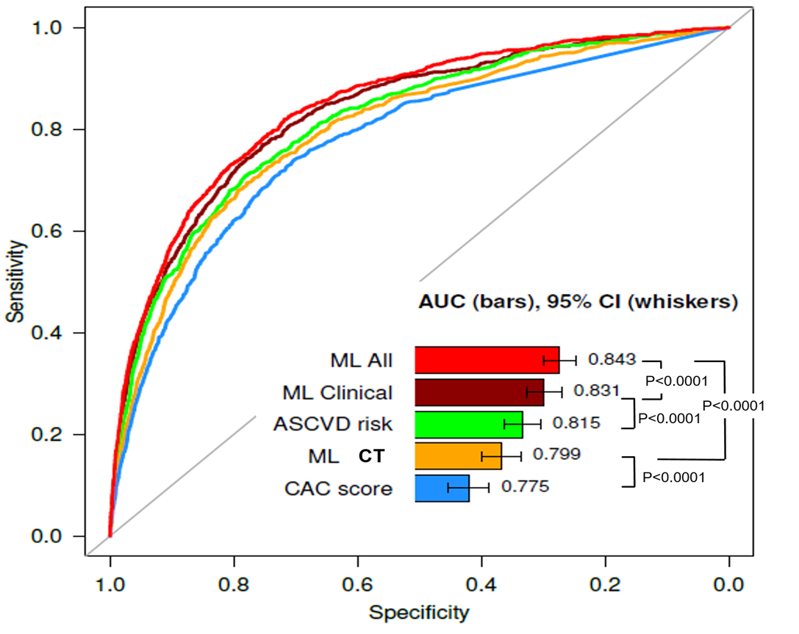
ML superior to clinical and CAC scores in predicting 12-year CHD and CVD
Cardiac death 524/66636 events
Cardiovascular death 971/66636 events
Nakanishi/Slomka et al. AHA 2017

Slide 14
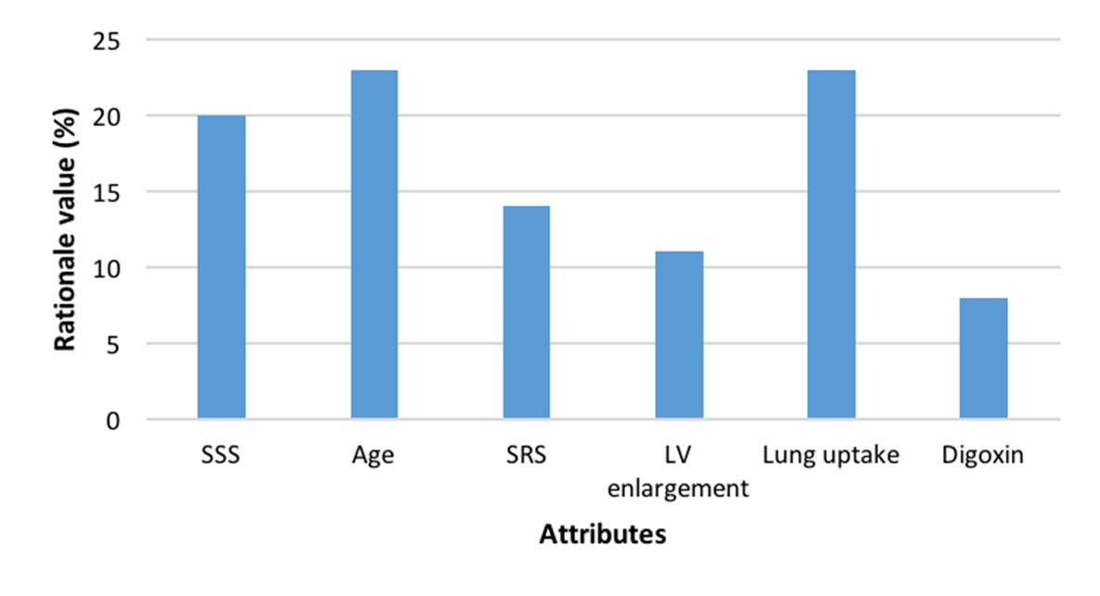
Does it have to be a “black box” ? ML prediction rationale for a given patient Alonso H et al, A Simple Model for Prediction of Cardiac Death ASNC 2016
Male 68 y/o SSS=29 SRS=28
In a clinical setting, it will be possible to interpret an individual ML assessment

Slide 15
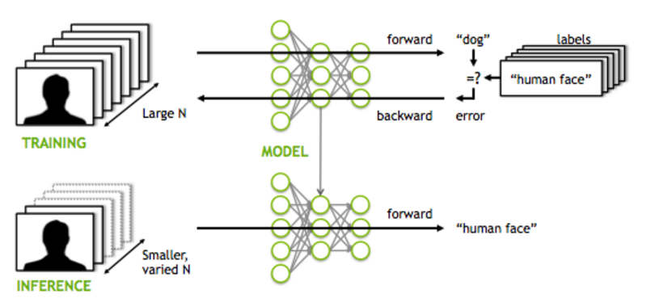
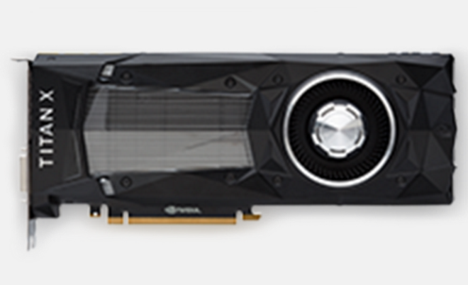
Deep learning
Pretrained
nets
with > 1 mln
natural images
available
https://developer.nvidia.com/deep-learning caffe.berkeleyvision.org

Slide 16
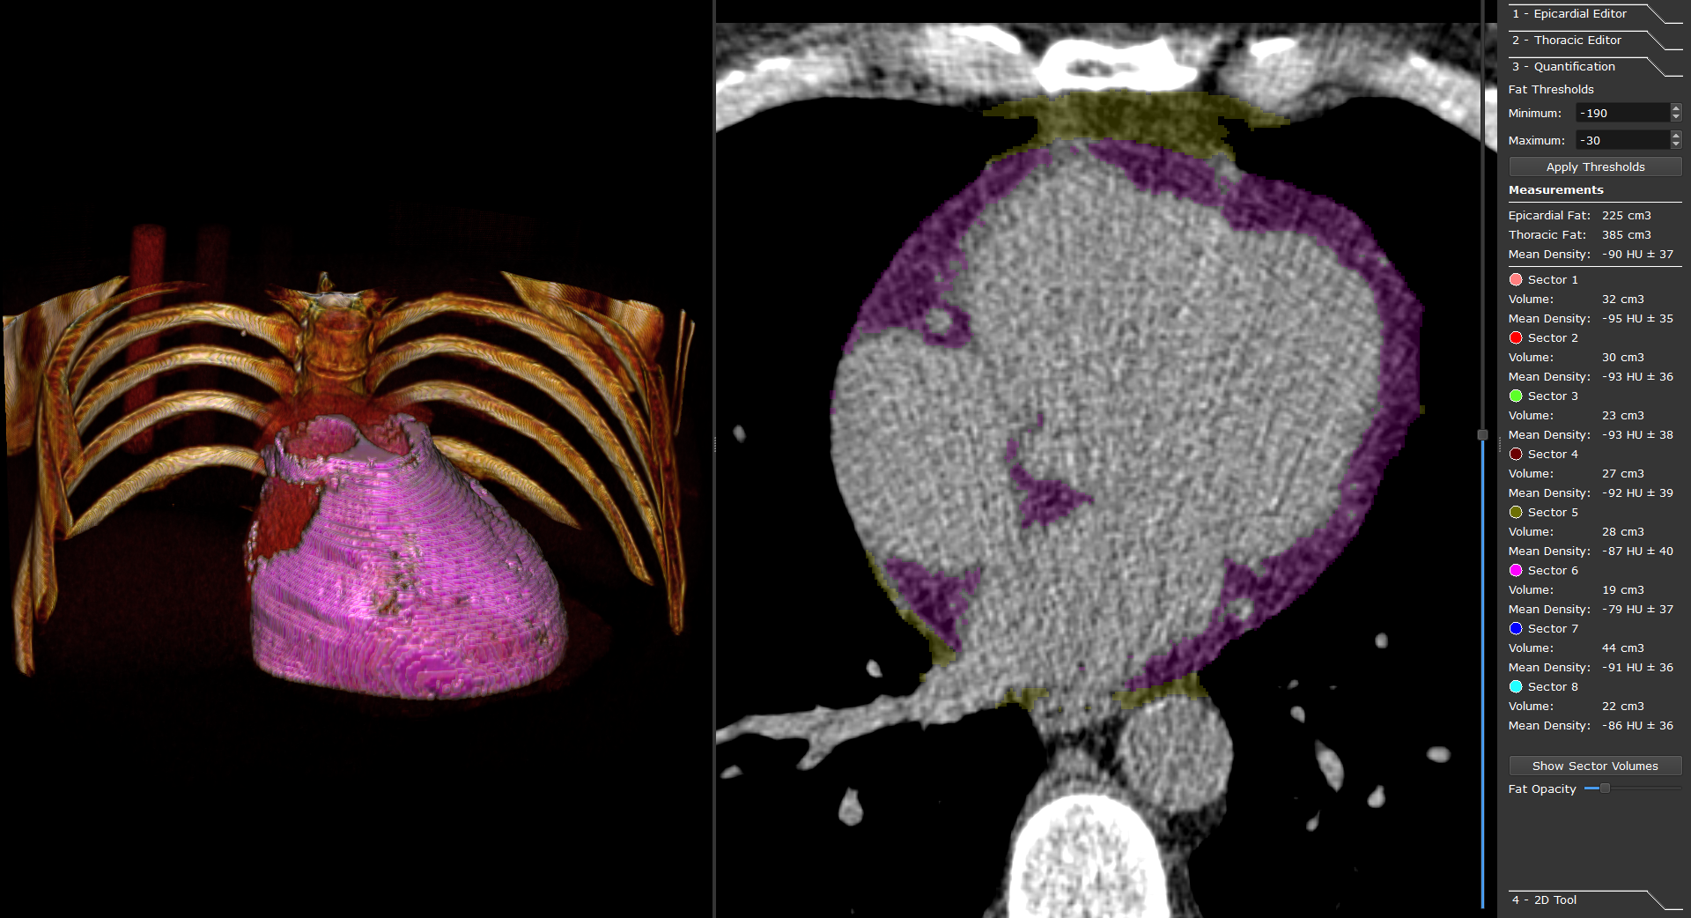
Deep learning for adipose tissue segmentation from non-contrast CT
Dey D R01HL133616
>7000 patients

Slide 17
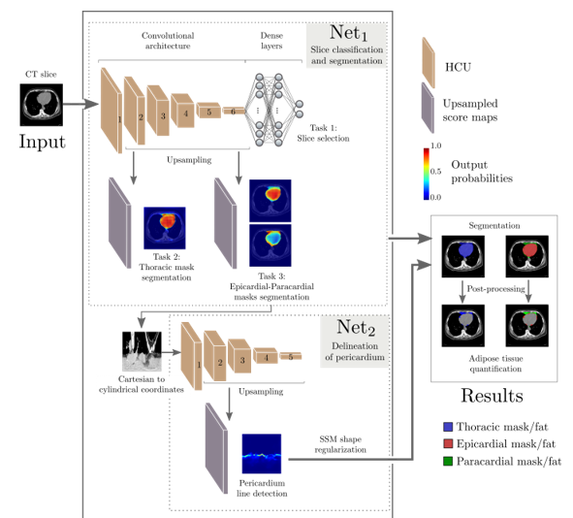
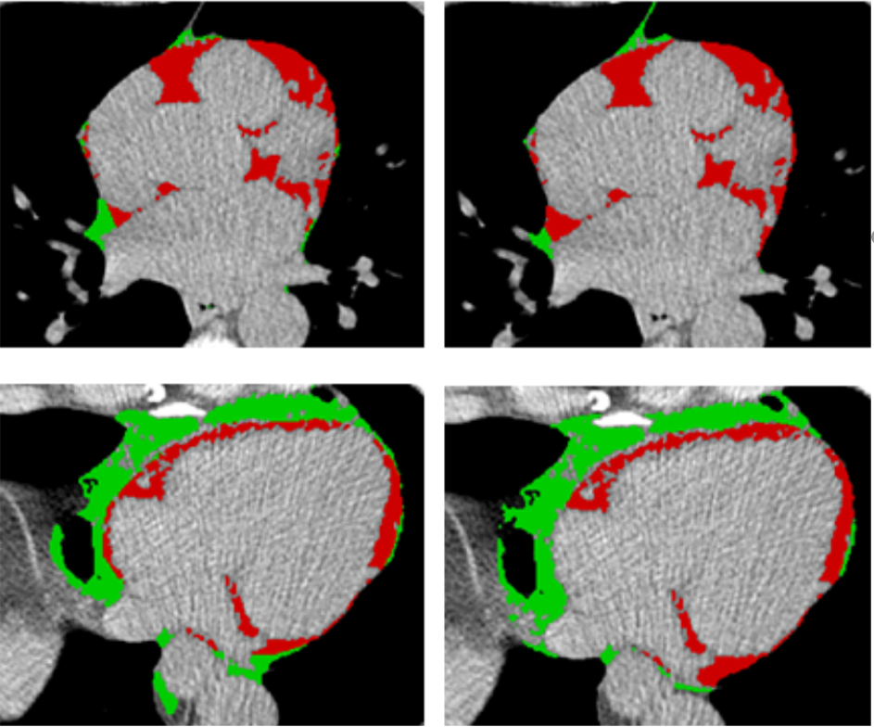
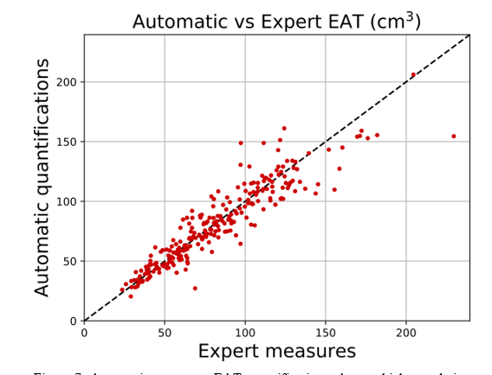
Deep learning for image analysis non-contrast CT pericardial fat segmentation
Deep learning
Ground truth by expert
R=0.95
R=0.93
Caffe:4 layers convolution/activation output per-pixel probability
Training 1100 slices: few hours on 2x Nvidia GTX1080. Testing < 5 sec per patient
Dey D NIH RO1:1R01HL133616
Commandeur et al SCCT, RSNA 2017

Slide 18
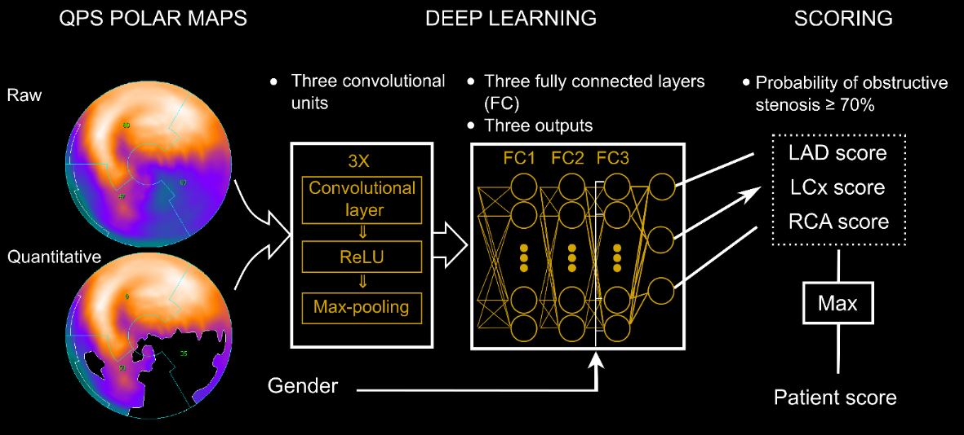
Predict obstructive disease with Deep learning
Does DL enhances standard prediction of obstructive disease by total perfusion deficit (TPD)?
LAD
LCX
RCA
Patient score
Betancur, ASNC 2017
Notes:
In this work we assess the added value of deep convolutional neural networks for the prediction of obstructive disease from fast SPECT myocardia perfusion imaging as compared to the prediction by standard total perfusion deficits (TPD)

Slide 19
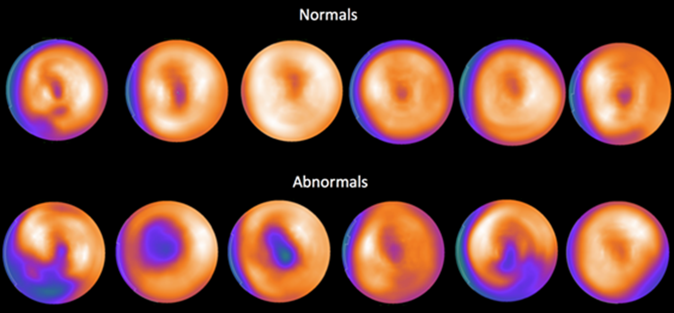
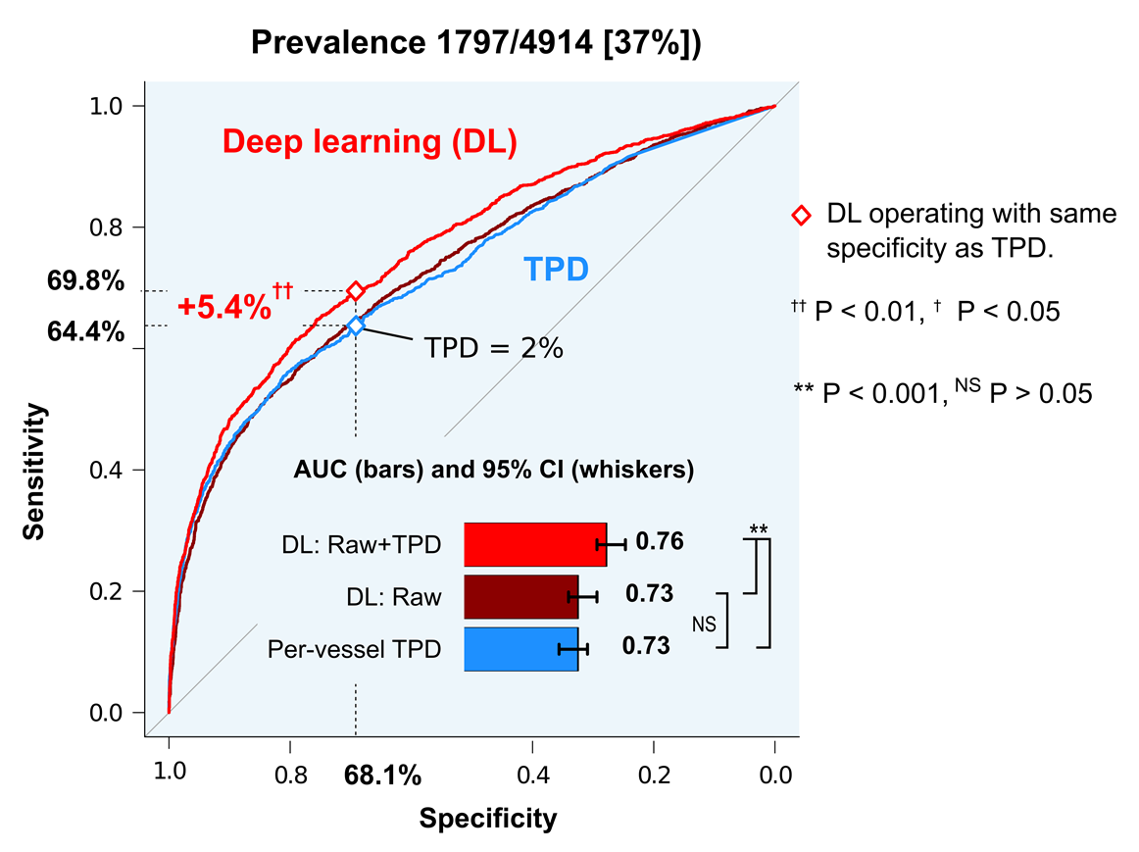
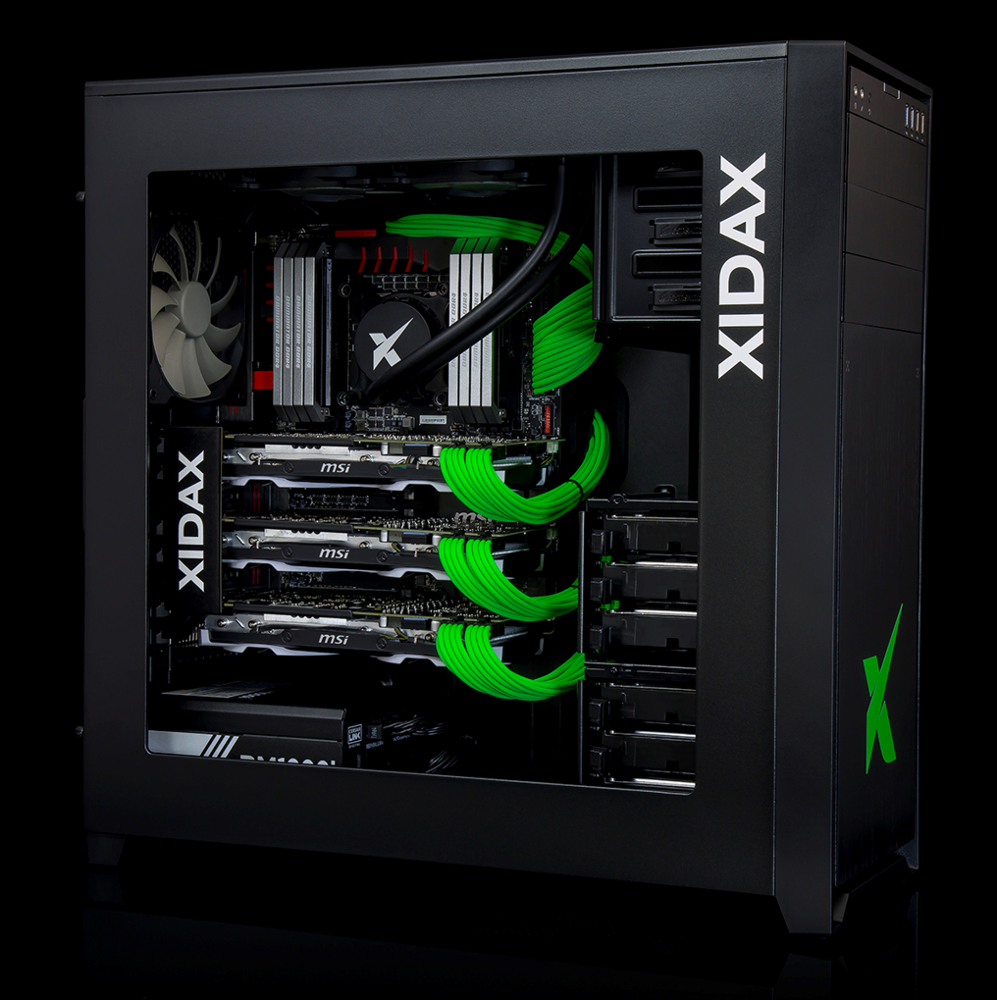
Deep learning: prediction of obstructive disease from polar maps
N =1638 MPI with invasive angiography (10-fold cross validation)
NIH NHLBI grant R01HL089765
Multi site MPI registry
Preliminary work
Training 1 hr.
Testing per case < 1sec
AUC- area under curve
TPD –total perfusion deficit (current method)
Betancur et al , ASNC 2017

Slide 20
Collected to date > 2,000 cases with cath, 18,500 with MACE follow up
REgistry of Fast Myocardial Perfusion Imaging with NExt generation SPECT: ReFINe SPECT
NIH sponsored diagnostic/prognostic image registry, 9 national/international sites
Site | System | Protocols
Cedars-Sinai , Los Angeles Slomka, Berman | D-SPECT | Sestamibi rest/stress supine/upright
Aspire, Kansas City Bateman | DSPECT Siemens Symbia SPECT/CT | Low-dose sestamibi stress or stress/rest supine/upright ~50% stress-only AC for Symbia
Columbia, New York Einstein | GE 530c | Sestamibi prone/supine
Assuta, Israel Sharir | GE 530c | Low dose sestamibi supine/prone
Oregon Heart/Vascular Institute Fish | D-SPECT | Sestamibi rest supine stress supine/upright
Zurich University Hospital Kaufmann | GE 570c SPECT/CT GE Ventri/VCT SPECT/CT | Low-dose tetrofosmin stress/rest AC for all
Ottawa Heart Institute Canada Ruddy | GE 530c GE Infinia SPECT/CT | Low-dose tetrofosmin AC for GE Infinia
Yale University, New Haven, Miller, Sinusas | GE570c SPECT/CT GE Infinia SPECT/CT | Stress/rest sestamibi protocols. AC for all
Brigham and Women’s Boston Dorbala, DiCarli | D-SPECT Siemens Symbia SPECT/CT (IQ∙SPECT) | Same-day, dose-dependent rest/stress sestamibi. Supine/upright for D-SPECT AC for Symbia
All images automatically processed!
NIH NHLBI grant R01HL089765

Slide 21
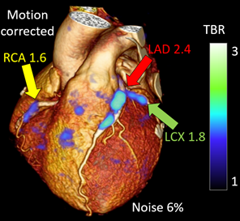
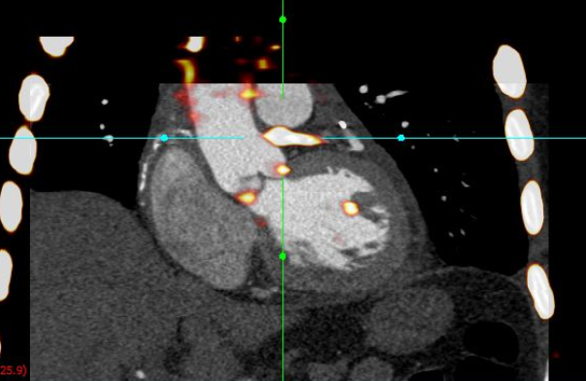
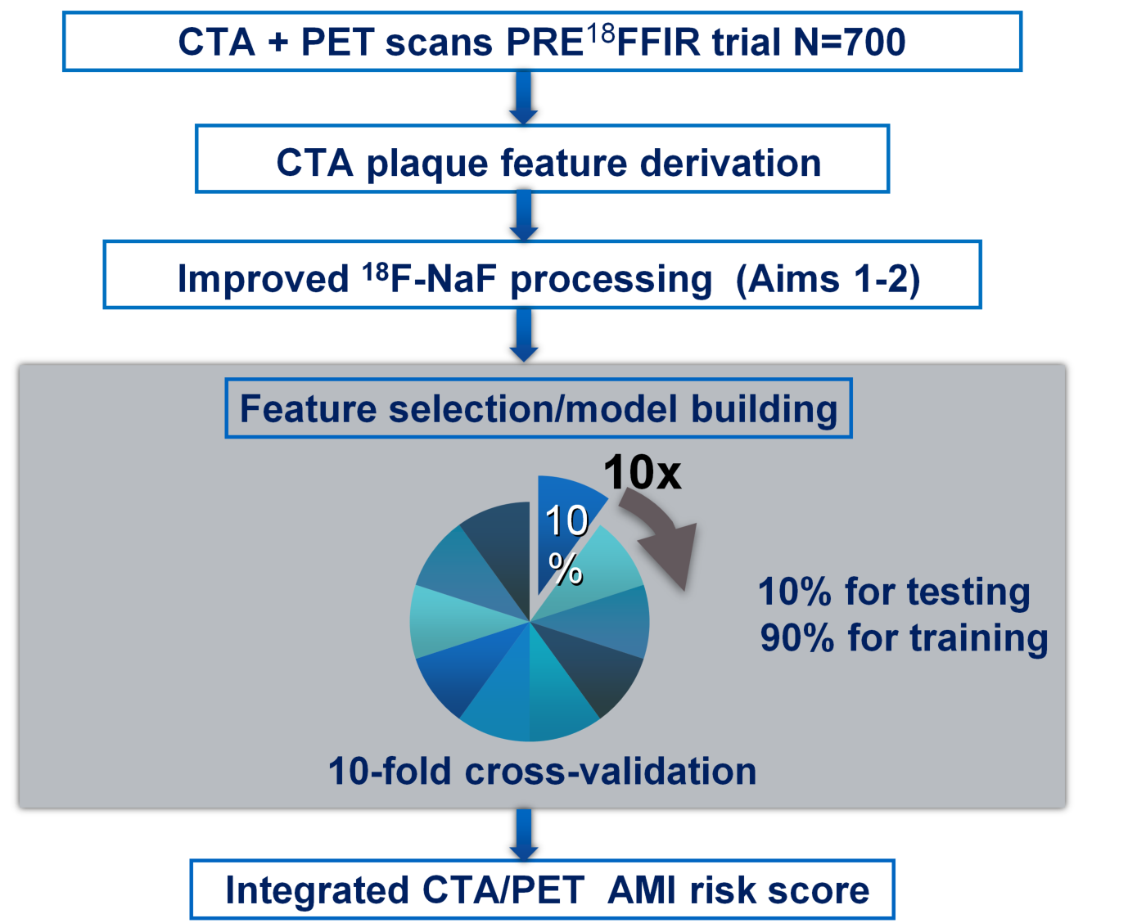
Multimodality machine learning CTA + coronary PET for prognosis of heart attacks in high risk patients ?
Coronary PET quantification
Coronary ¹⁸F-NaF PET +CTA
Prediction of Recurrent Events With ¹⁸F-Fluoride (PREFFIR) ClinicalTrials.gov NCT02278211
Joshi et al Lancet 2014
Rubeaux et al JNM 2016
R01 HL135557

Slide 22
Software vs physician?
“Patients whose lives and medical histories shape the algorithms, will emerge the biggest winners as machine learning transforms clinical medicine”
Obermayer and Emanuel New England Journal of Medicine 2016

Slide 23
Machine learning in cardiac imaging
Machine learning (ML) combines multiple imaging and clinical datapoints in one score.
Deep learning perform image segmentation
ML can predict disease, intervention, or outcomes in terms of post-test probability
Quantitative computer interpretation will help clinicians find the right answer for a given patient

