Slide 1
Machine Learning
Outperformed
ACC/AHA Pooled Cohort Equations Risk Calculator for Detection of High-Risk Asymptomatic Individuals and Recommending Treatment for Prevention of Cardiovascular Events in the Multi-Ethnic Study of Atherosclerosis (MESA)
Ioannis A. Kakadiaris, Ph.D.¹, Michalis Vrigkas, Ph.D.¹, Matthew Budoff, M.D.², Albert A. Yen, M.D.³, Morteza Naghavi, M.D.³
1: Computational Biomedicine Lab, University of Houston, Houston, TX, USA
2: Division of Cardiology, Los Angeles Biomedical Research at Harbor-UCLA Medical Center, Torrance, CA, USA
3: Society for Heart Attack Prevention and Eradication, Houston, TX, USA

Slide 2
Introduction
Background
Several studies have demonstrated that current cardiovascular disease (CVD) risk prediction in the U.S., using the ACC/AHA Pooled Cohort Equations Risk Calculator, is inaccurate and can result in overtreatment of low-risk and undertreatment of high-risk individuals.
Objectives
The goal of this study was to utilize Machine Learning (ML) to derive a more accurate CVD risk predictor.

Slide 3
MESA
The Multi-Ethnic Study of Atherosclerosis
Prospective cohort study initiated in July 2000
All participants were free of any clinical CVD at first examination
6,814 men and women, age 45-84 years at the baseline exam
White (38%), African-American (28%), Hispanic (22%), Chinese-American (12%)
Monitored annually for incident CVD events
13-year follow up data now available

Slide 4
Overview of ML Approach
Prepare Study Dataset
Apply Machine Learning
Cross-Validation
10 x

Slide 5
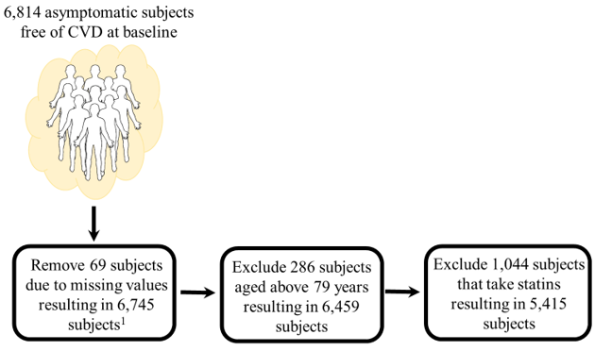
Prepare Study Dataset
MESA
Study Population
5,415 subjects

Slide 6
Baseline Characteristics of Study Population and CVD Event Subgroups
 | Non-Statin Users |  |  | Statin Users
 | All Study Population (N = 5,415) | Hard CVD (N = 381) | All CVD (N = 775) | Lipid Lowering Medication (N = 1,044)
Age, y | 60.6 ± 9.7 | 65.5 ± 9.2 | 65.5 ± 9.0 | 65.0 ± 8.3
Male, n% | 2,563 (47.3%) | 222 (58.3%) | 477 (61.6%) | 497 (47.6%)
Female, n% | 2,852 (52.7%) | 159 (41.7%) | 298 (38.5%) | 547 (52.4%)
Ethnicity, n%
White | 2,028 (37.5%) | 145 (38.0%) | 322 (41.5%) | 456 (43.7%)
Asian | 663 (12.2%) | 27 (7.1%) | 52 (6.7%) | 104 (10.0%)
African American | 1,484 (27.4%) | 107 (28.1%) | 223 (28.8%) | 296 (28.3%)
Hispanic | 1,240 (22.9%) | 102 (26.8%) | 178 (23.0%) | 188 (18.0%)
Total Cholesterol, mg/dL | 196.6 ± 35.5 | 197.6 ± 33.8 | 195.9 ± 36.1 | 182.9 ± 35.3
HDL Cholesterol, mg/dL | 51.0 ± 14.9 | 47.7 ± 14.0 | 47.8 ± 13.7 | 50.3 ± 13.9
Systolic Blood Pressure, mm Hg | 125.3 ± 21.0 | 135.7 ± 22.2 | 134.5 ± 21.9 | 129.2 ± 21.5
Hypertension, n% | 1,724 (31.8%) | 173 (45.4%) | 364 (47.0%) | 627 (60.1%)
Diabetes, n% | 505 (9.3%) | 69 (8.1%) | 147 (19.0%) | 224 (21.5%)
Smoking, n%
Current Smoking | 765 (14.1%) | 79 (20.7%) | 145 (18.7%) | 104 (10.0%)
Prior Smoking | 1,938 (35.8%) | 134 (35.2%) | 314 (40.5%) | 427 (40.9%)
Never | 2,712 (50.1%) | 168 (44.1%) | 316 (40.8%) | 513 (49.1%)
*Family History Heart Attack, n% | 2,082 (38.5%) | 184 (48.3%) | 370 (47.7%) | 511 (48.9%)
*Coronary Artery Calcification, Agatston | 118.1 ± 370.0 | 284.8 ± 557.3 | 355.4 ± 713.2 | 246.0 ±556.3
*hsCRP, mg/L | 3.9 ± 6.0 | 4.4 ± 6.3 | 4.6 ± 7.0 | 3.3 ± 5.0

Slide 7
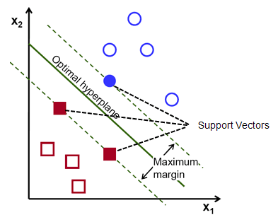
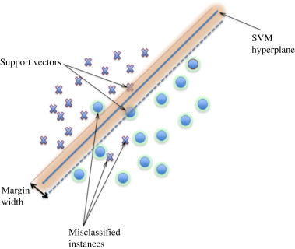
Support Vector Machines (SVM)
Powerful ML algorithm for binary classification problems
Given a training set of examples belonging to two classes → finds the optimal (maximum margin) hyperplane that separates the input data

Slide 8
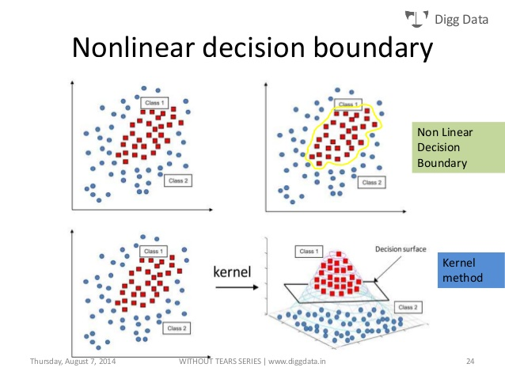
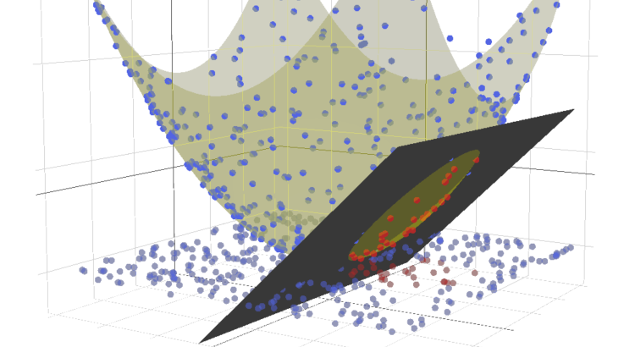
Support Vector Machine - SVM
Binary Classification
Features
Optimization – maximize margin

Slide 9
NEATER
(filteriNg of ovErsampled dAta using non-cooperaTive gamE theoRy)
A data augmentation algorithm – necessary because the MESA data are severely imbalanced in terms of outcomes (events << no events)
Based on filtering oversampled data using non-cooperative game theory
Increases the performance of the classifier while avoiding the problem of over-fitting
In this study, used only for training and never during prediction

Slide 10
Two-Fold Cross Validation
The Nine Predictor Variables
age, gender, ethnicity, total cholesterol, HDL cholesterol, systolic blood pressure, treatment for hypertension, history of diabetes, and smoking status

Slide 11
Characteristics of Study Population and Risk Category Subgroups
 | All Study Population (N = 5,415) | ACC/AHA < 9.75% 13yr risk (N = 3,092) | ACC/AHA ≥ 9.75% 13yr risk (N = 2,323) | ML: Low Risk (13yr) (N = 4,844) | ML: High Risk (13yr) (N = 571)
Age, y | 60.6 ± 9.7 | 54.9 ± 6.9 | 68.2 ± 7.2 | 59.9 ± 9.6 | 66.0 ± 8.6
Male, n% | 2,563 (47.3%) | 1,119 (36.2%) | 1,445 (62.2%) | 2,204 (45.5%) | 359 (62.9%)
Female, n% | 2,852 (52.7%) | 1,973 (63.8%) | 878 (37.8%) | 2,640 (54.5%) | 212 (37.1%)
Ethnicity, n%
White | 2,028 (37.5%) | 1,224 (39.6%) | 804 (34.6%) | 1,806 (37.3%) | 222 (38.9%)
Asian | 663 (12.2%) | 405 (13.1%) | 258 (11.1%) | 602 (12.4%) | 61 (10.7%)
African American | 1,484 (27.4%) | 717 (23.2%) | 767 (33.0%) | 1,334 (27.5%) | 150 (26.2%)
Hispanic | 1,240 (22.9%) | 746 (24.1%) | 494 (21.3%) | 1,102 (22.8%) | 138 (24.2%)
Total Cholesterol, mg/dL | 196.6 ± 35.5 | 196.2 ± 34.7 | 197.1 ± 36.5 | 196.7 ± 35.9 | 195.8 ± 31.3
HDL Cholesterol, mg/dL | 51.0 ± 14.9 | 52.7 ± 15.0 | 48.7 ± 14.5 | 51.5 ± 15.1 | 46.8 ± 12.9
Systolic Blood Pressure, mm Hg | 125.3 ± 21.0 | 116.7 ± 16.5 | 136.8 ± 21.0 | 124.2 ± 20.8 | 134.9 ± 20.3
Hypertension, n% | 1,724 (31.8%) | 578 (18.7%) | 1,146 (49.3%) | 1,468 (30.3%) | 256 (44.8%)
Diabetes, n% | 505 (9.3%) | 99 (3.2%) | 406 (17.5%) | (7.0%) | (15.2%)
Smoking, n%
Current Smoking | 765 (14.1%) | 352 (11.4%) | 413 (17.8%) | 663 (13.7%) | 102 (17.9%)
Prior Smoking | 1,938 (35.8%) | 1,036 (33.5%) | 902 (38.8%) | 1,724 (35.6%) | 214 (37.4%)
Never | 2,712 (50.1%) | 1,704 (55.1%) | 1,008 (43.4%) | 2,457 (50.7%) | 255 (44.7%)
*Family History Heart Attack, n% | 2,082 (38.5%) | 1,158 (37.5%) | 923 (39.7%) | 1,830 (37.8%) | 252 (44.1%)
*Coronary Artery Calcification, Agatston | 118.1 ± 370.0 | 36.3 ± 155.7 | 227 ±515.9 | 103.6 ± 344.6 | 242.0 ± 524.7
*hsCRP, mg/L | 3.9 ± 6.0 | 3.7 ± 5.4 | 4.2 ± 6.6 | 3.9 ± 5.9 | 3.6 ± 6.0

Slide 12
Risk Calculator Comparison
Model | Sn | p | Sp | p | FN | FP | TP | TN | Acc | NRI
All
AHA Risk Calculator (Hard CVD) | 0.74 ± 0.1 | --- | 0.60 ± 0.1 | --- | 98 | 2,040 | 283 | 2,994 | 0.60 | ---
ML Risk Calculator (Hard CVD) | 0.85 ± 0.1 | ≤0.001 | 0.95 ± 0.1 | ≤0.001 | 57 | 247 | 324 | 4,787 | 0.95 | 0.45
AHA Risk Calculator (All CVD) | 0.73 ± 0.1 | --- | 0.62 ± 0.1 | --- | 204 | 1,752 | 571 | 2,888 | 0.64 | ---
ML Risk Calculator (All CVD) | 0.95 ± 0.1 | ≤0.001 | 0.88 ± 0.1 | ≤0.001 | 38 | 575 | 737 | 4,065 | 0.89 | 0.48
Sn = sensitivity
Sp = specificity
p = p-value
FN = false negative
FP = false positive
TP = true positive
TN = true negative
Acc = accuracy
NRI = net reclassification improvement

Slide 13
Risk Calculator Comparison – Male and Female
Model | Sensitivity | p-value | Specificity | p-value | FN | FP | TP | TN | Accuracy | NRI
Male
AHA Risk Calculator (Hard CVD) | 0.84 ± 0.1 | --- | 0.46 ± 0.1 | --- | 36 | 1,259 | 186 | 1,082 | 0.50 | ---
ML Risk Calculator (Hard CVD) | 0.89 ± 0.1 | ≤0.001 | 0.93 ± 0.1 | ≤0.001 | 24 | 161 | 198 | 2,180 | 0.93 | 0.52
AHA Risk Calculator (All CVD) | 0.77 ± 0.1 | --- | 0.53 ± 0.1 | --- | 112 | 988 | 365 | 1,098 | 0.57 | ---
ML Risk Calculator (All CVD) | 0.97 ± 0.1 | ≤0.001 | 0.83 ± 0.1 | ≤0.001 | 13 | 358 | 464 | 1,728 | 0.86 | 0.50
Female
AHA Risk Calculator (Hard CVD) | 0.61 ± 0.1 | --- | 0.71 ± 0.1 | --- | 62 | 781 | 97 | 1,912 | 0.70 | ---
ML Risk Calculator (Hard CVD) | 0.79 ± 0.1 | ≤0.001 | 0.97 ± 0.1 | ≤0.001 | 33 | 86 | 126 | 2,607 | 0.96 | 0.44
AHA Risk Calculator (All CVD) | 0.60 ± 0.1 | --- | 0.76 ± 0.1 | --- | 137 | 608 | 161 | 1,946 | 0.74 | ---
ML Risk Calculator (All CVD) | 0.92 ± 0.1 | ≤0.001 | 0.92 ± 0.1 | ≤0.001 | 25 | 217 | 273 | 2,337 | 0.92 | 0.48
All
AHA Risk Calculator (Hard CVD) | 0.74 ± 0.1 | --- | 0.60 ± 0.1 | --- | 98 | 2,040 | 283 | 2,994 | 0.60 | ---
ML Risk Calculator (Hard CVD) | 0.85 ± 0.1 | ≤0.001 | 0.95 ± 0.1 | ≤0.001 | 57 | 247 | 324 | 4,787 | 0.95 | 0.45
AHA Risk Calculator (All CVD) | 0.73 ± 0.1 | --- | 0.62 ± 0.1 | --- | 204 | 1,752 | 571 | 2,888 | 0.64 | ---
ML Risk Calculator (All CVD) | 0.95 ± 0.1 | ≤0.001 | 0.88 ± 0.1 | ≤0.001 | 38 | 575 | 737 | 4,065 | 0.89 | 0.48

Slide 14
ROC Curves
ML Risk Calculator (blue)
ACC/AHA Risk Calculator (red)
Hard CVD
All CVD
AUC = 0.95
AUC = 0.92
AUC = 0.72
AUC = 0.73

Slide 15
Who Should Take Statin?

Slide 16
Missed Treatment Opportunities

Slide 17
Summary of Results
 | Recommend statin | “Hard CVD” events in those in “No Statin” | Sensitivity | Specificity | AUC
ACC/AHA | 42.9% | 25.7% | 0.74 | 0.60 | 0.72
ML | 10.6% | 15.0% | 0.85 | 0.95 | 0.92
According to the ACC/AHA Risk Calculator and a 7.5% 10-year risk threshold, 42.9% would be statin eligible. Despite this high proportion, 25.7% of the 381 “Hard CVD” events occurred in those not recommended statin, resulting in sensitivity (Sn) 0.74, specificity (Sp) 0.60, and AUC 0.72. In contrast, the ML Risk Calculator recommended only 10.6% to take statin, and only 15.0% of “Hard CVD” events occurred in those not recommended statin, resulting in Sn 0.85, Sp 0.95, and AUC 0.92. Similar results were obtained when comparing prediction of “All CVD” events.

Slide 18
Comparison to similar ML study
Weng SF, Reps J, Kai J, Garibaldi JM, Qureshi N. Can machine-learning improve cardiovascular risk prediction using routine clinical data? PLoS One 2017;12(4):e0174944.
Study | Cohort | ML used | Approach | Variables other than ACC/AHA? | Improvement in AUC compared to ACC/AHA
Weng et al. | UK clinic patients N = 378,256 | random forest logistic regression gradient boosting machines neural networks | 75% for training 25% for validation | Yes (22 additional) | +1.7% +3.2% +3.3% +3.6%
Our study | MESA N=5,214 | SVM, NEATER | Cross-validation | No | + 27.8%

Slide 19
Conclusions
Our ML Risk Calculator clearly outperformed the ACC/AHA Risk Calculator by recommending less drug therapy and missing fewer events.
Further studies are underway to validate these findings in other large cohorts.

Slide 20
Future Directions
Train the ML Risk Calculator on other multi-ethnic cohorts or various cohorts with different ethnicities across the globe based on the same traditional risk factors.
Train the ML Risk Calculator with additional variables besides the traditional risk factors. The scope of the new variables can range from a few new biomarkers to a large number of variables including all variables already measured in the cohorts as well as newly measured genetic and proteomic variables in stored specimen.
Train the ML Risk Calculator to characterize subjects based on CT images obtained for coronary calcium scoring with the hope of detecting potential new markers of risk besides the total score.
As we introduce our ML Risk Calculator to more data, particularly to cases in which events occurred weeks or months following data collection instead of years, short-term risk prediction may become possible.

