Slide 1
Triggers of Cardiovascular Events
Robert A. Kloner MD, PhD
Vice President of Translation and
Director of Cardiovascular Research Institute
Interim Chief Science Officer
Huntington Medical Research Institutes, Pasadena, CA
Professor of Medicine (Clinical Scholar)
Cardiovascular Division, Dept. of Medicine
Keck School of Medicine of University of Southern California, Los Angeles, CA
Editor-in-Chief, Journal of Cardiovascular Pharmacology And Therapeutics

Slide 2
Conflict of Interest/Disclosure: None

Slide 3
Definitions
Trigger: An activity that produces short-term physiological changes that may lead directly to onset of acute cardiovascular disease.
Acute risk factors: A short-term physiological change, such as a surge in arterial pressure or heart rate, an increase in coagulability, or vasoconstriction, that follows a trigger and may result in disease onset.
From Tofler GH, Muller JE. Circulation 2006; 114:1863-1872.

Slide 4
Triggers of Cardiovascular Events
The wake-up time (morning)
Day of the week (Monday)
Seasonal variation
winter, cold, blizzards
the winter holiday season
heat waves
infection
influenza
Physical activity
heavy, moderate exertion
sexual activity

Slide 5
Triggers of Cardiovascular Events
Psychosocial
emotional upset
anger
anxiety
bereavement
work-related stress (high-pressure work deadline)
Sporting events
Sexual activity

Slide 6
Triggers of Cardiovascular Disease
Lack of sleep
Overeating
Population stressors
earthquake
blizzard
wartime missile attacks
sporting events
terrorist attacks (?)
high air pollution days
Respiratory infection (flu season)
Drugs
cocaine
marijuana

Slide 7
Possible Triggers of Acute Myocardial Infarction

Slide 8
Myocardial Infarction Onset Study Anger can trigger myocardial infarction

Slide 10
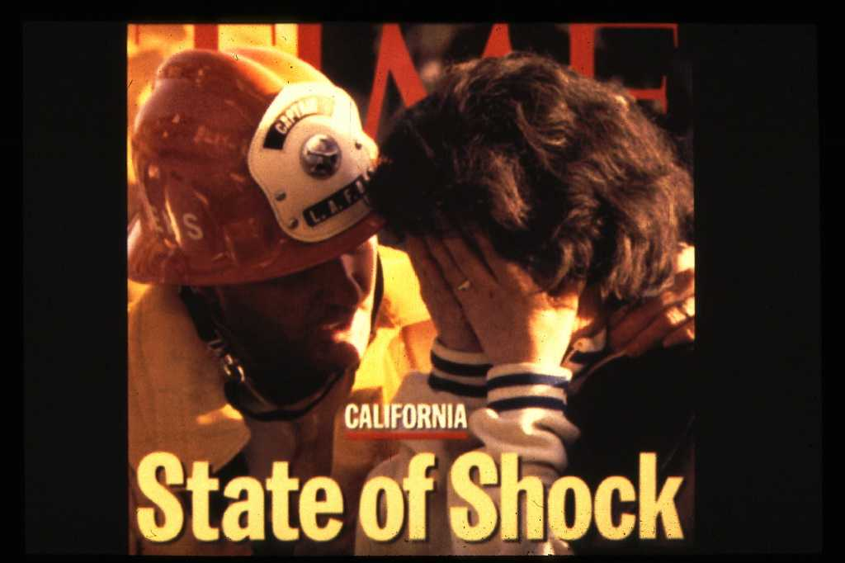

Slide 11
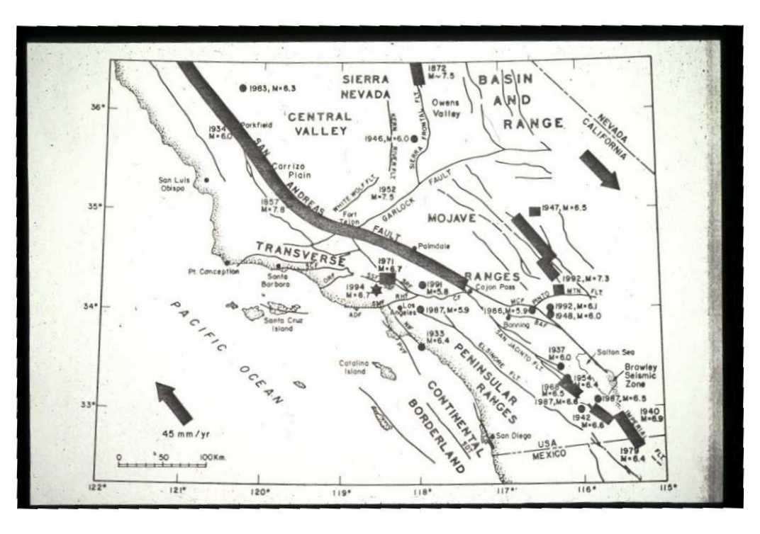

Slide 12
CCU Admissions for Myocardial Infarction
Overall, a 35% increase in the number of infarctions in the week after the earthquake

Slide 13
% of CCUs With Increase in Number of MI Admissions
In the Week After the Earthquake
Miles from Epicenter

Slide 14
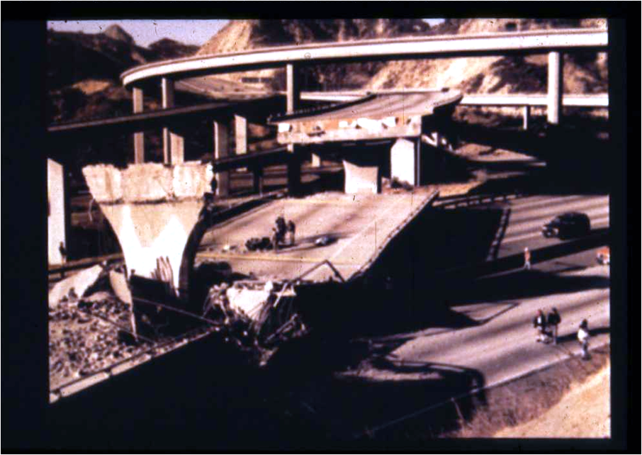

Slide 19
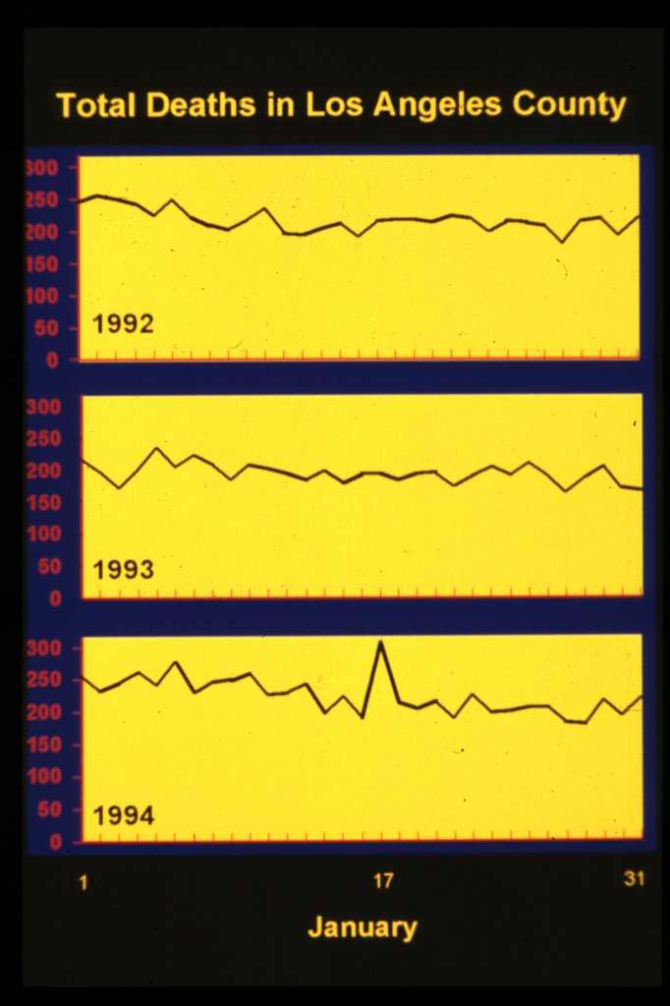

Slide 20
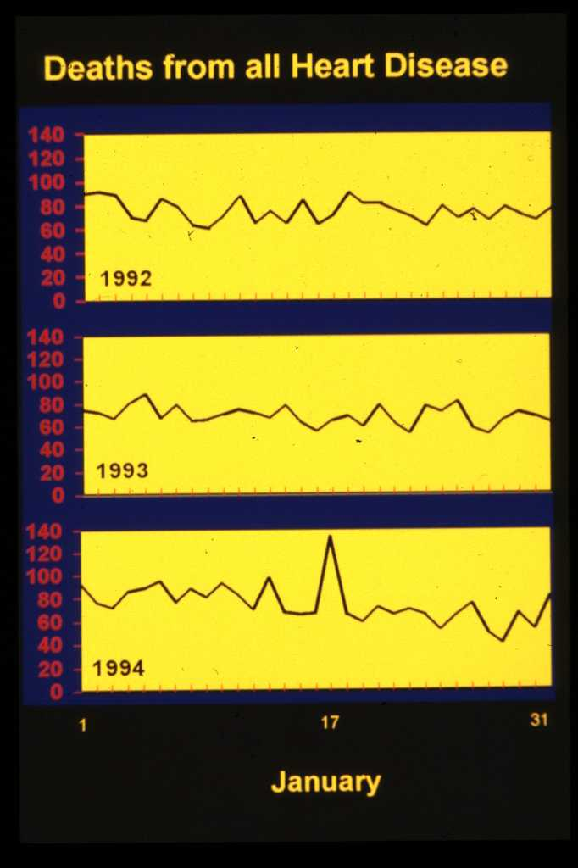

Slide 21
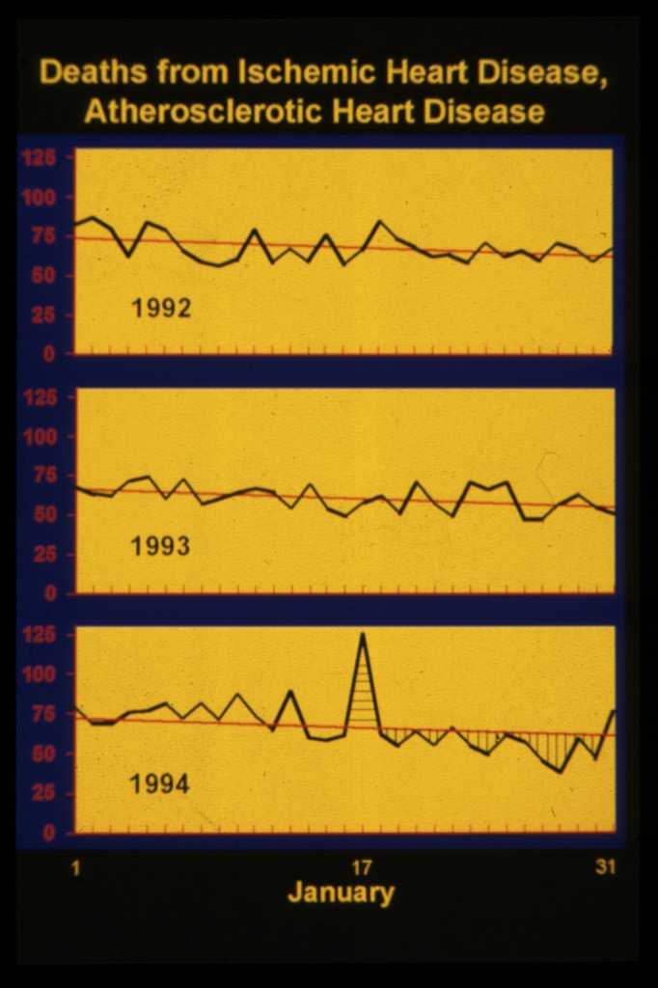

Slide 22
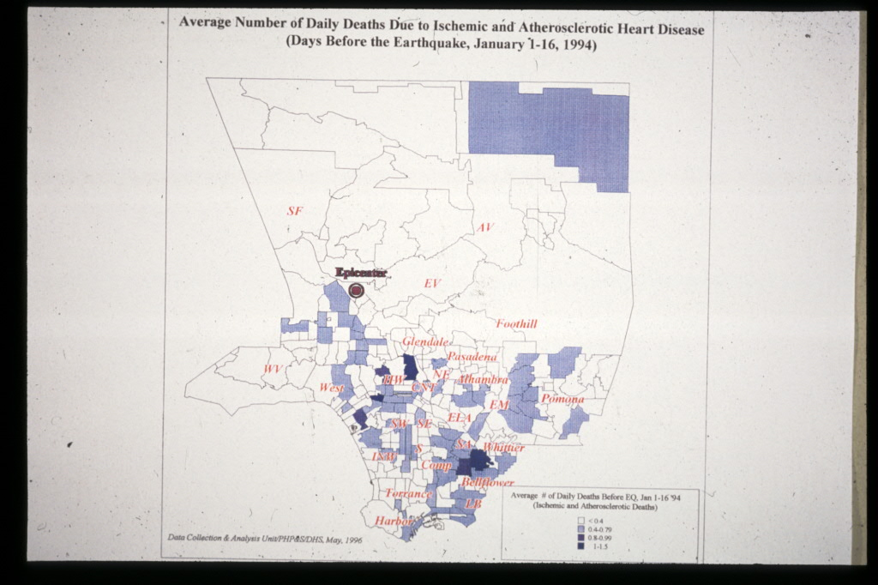

Slide 23
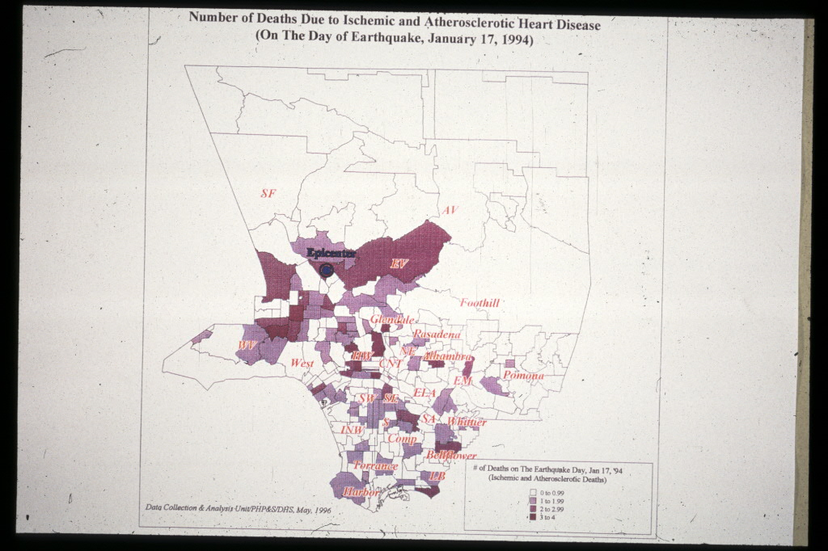

Slide 24
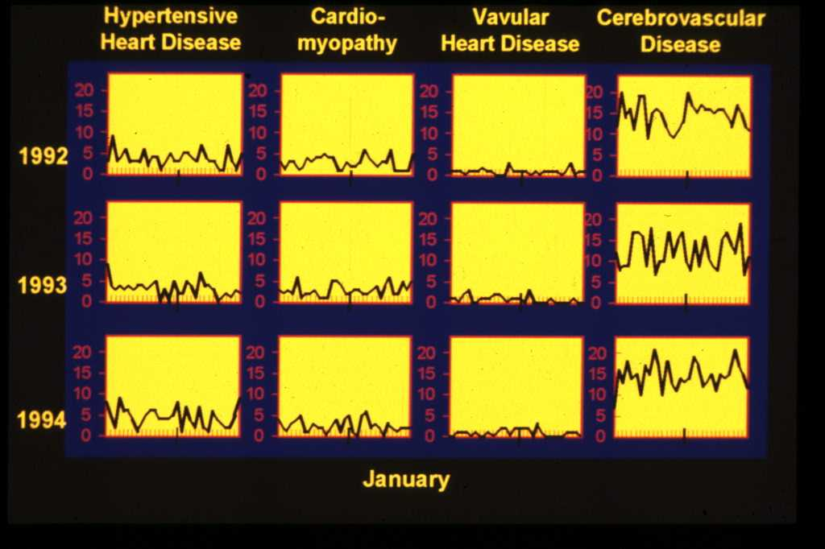

Slide 25
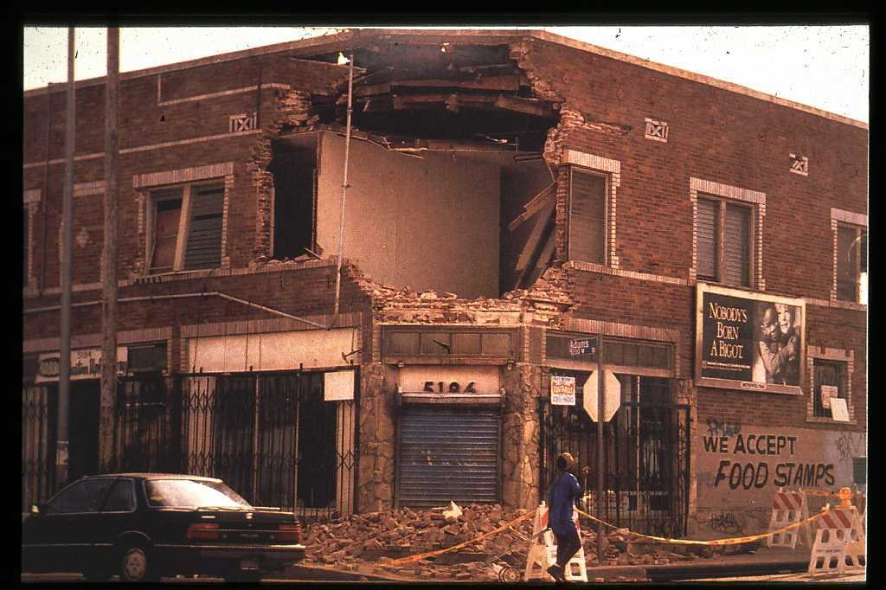

Slide 26
Increase in Deaths from Ischemic Heart Disease after Blizzards
Glass RI, Zack MM. Lancet, 1979
Death certificates in eastern Massachusetts after 6 blizzards in 1974-1978 were examined to identify effects of mortality from these storms.
Total number of deaths was 8% higher in a “blizzard week” than in preceding and subsequent control weeks (114 vs. 105 deaths per day).

Slide 27
Increase in Deaths from Ischemic Heart Disease after Blizzards (cont.)
Deaths from ischemic heart disease rose by 22% in blizzard week from 36.7 to 44.6 deaths per day.
Increase was greater in males than in females (30% vs. 12%).
Since increase in ischemic heart disease deaths continued for 8 days after the snowstorm, the effect was likely related to activities such as show shoveling.

Slide 28
Mean Coronary Deaths

Slide 29
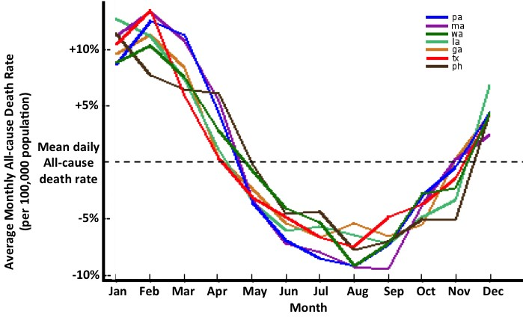

Slide 30
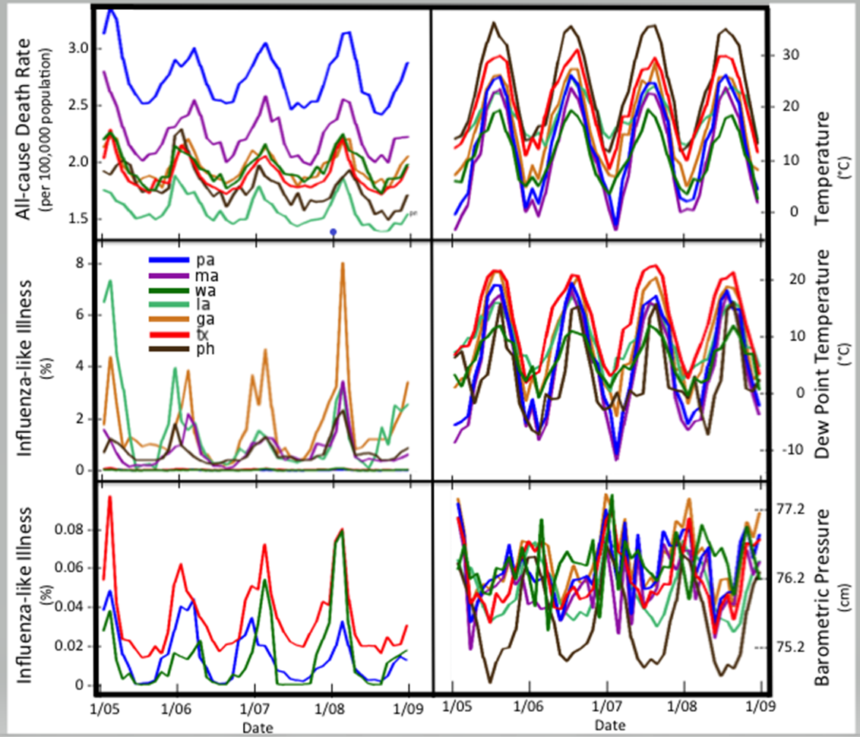

Slide 31
Total Number of CAD Deaths by Day Nov, Dec, Jan

Slide 35
Introduction to Super Bowl Study
Intense European soccer has been associated with an increase in cardiac events
There is less information about high-profile sporting events in the U.S.
The purpose of our study was to determine whether there were changes in local death rates when a football team, representing a local population (Los Angeles), participated in the Super Bowl
We analyzed death rates from LA County for the day of and 2 weeks after a losing (1980) and winning (1984) Super Bowl and compared them with deaths for all other days from Jan 15 to the end of Feb for 1980-1983 and then for 1984-1988 (control days).

Slide 36
Super Bowl 1980 versus 1984
1980 (Jan 20, 1980)
Los Angeles Rams lost to Pittsburg Steelers
Rams had been in LA for many years (much loved team)
Very intense game. The lead changed 7 times
Rams were underdogs
Rams went into the 4th quarter with a lead but went on to lose
Game was played locally (Rose Bowl)

Slide 37
Super Bowl 1980 versus 1984
1984 (Jan 22, 1984)
Los Angeles Raiders beat the Washington Redskins
Raiders had been in LA only a few years
Raiders had a victory from the beginning
Raiders won by a large margin
Game was played out-of-state

Slide 38
1980 Super Bowl

Slide 39
1984 Super Bowl

Slide 40
Fat Intake After Losing Game
Cornil ,Y. , Chandon, P. Psychol Sci . 2013 ; 24: 1936
On Mondays following a Sunday NFL game, saturated fat increased 16% and food calorie intake increased 10% in cities with losing teams; decreased in cities with winning teams, and is unchanged in cities without NFL teams or in cities with NFL teams that did not play.

Slide 41
Conclusions
A Super Bowl with high drama/intensity can be associated with changes in cardiovascular death rates in a fan base with a strong attachment to the team, even in the contemporary era (with statins, antiplatelet therapies, etc.)

Slide 43
Potential Therapies
Control all long term risk factors for CVD:
for example statins for dyslipidemia; antihypertensive medicines; stop smoking; control diabetes; weight loss, etc.
Stress reduction, anger management, behavioral modification
Exercise programs to condition the heart

Slide 44
Potential Therapies (Continued)
Avoiding certain forms of heavy exertion (snow shoveling), especially if you are deconditioned
Avoid over-eating
? Slow, gradual awakening, gradual change in posture
Limiting time outdoors during high air pollution days

Slide 45
Potential Therapies (Continued)
Medicines – aspirin, beta blockers, calcium blockers, statins; ? Prophylactic nitroglycerin
Flu Shots
Devices – ICDs; public access defibrillators

Slide 47
Summary
Stress (physical or emotional) can adversely affect the heart by sympathetic and catecholamine mediated mechanisms.
Wake-up time, physical exertion, emotional stress, overeating, or lack of sleep may trigger cardiac events.
Emotional and physical stress associated with natural disasters such as earthquakes, blizzards, the holiday season and intense sporting events can contribute.
Recognizing the triggers, modulating stress and treating with some pharmacologic therapies may reduce the effects of these triggers.

Slide 48
Acknowledgements
Jonathan Leor, MD
Bryan Schwartz, MD
Research Triangle Institute, NC ( Ken Poole, PhD, Scott McDonald, PhD, R Perritt , PhD)
County of Los Angeles, Dept of Health Services Data Collection and Analysis Unit
Los Angeles County Coroner’s Office

