Slide 1

All of Us
Research Program
An Introduction to the
Philip Greenland, MD
@AllofUsResearch #JoinAllofUs

Slide 2
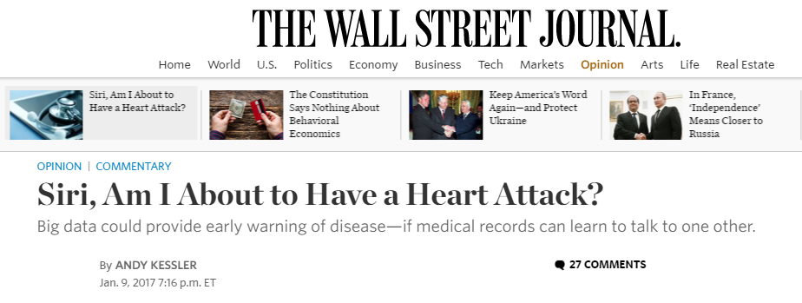

Slide 3
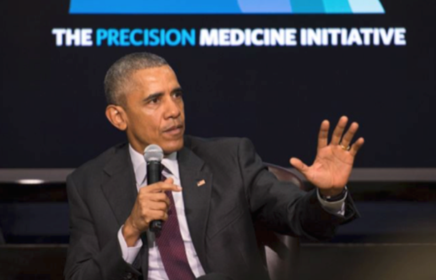
“My hope is that this becomes the foundation, the architecture, whereby in 10 years from now we can look back and say that we have revolutionized medicine.”
Announced by President Obama in his 2015 State of the Union address
—President Barack Obama
MISSION: To enable a new era of medicine through research, technology, and policies that empower patients, researchers, and providers to work together toward development of individualized care.

Slide 4
Overview of the All of Us Research Program

Slide 5
Budget for the All of Us Research Program
$130M
$230M
FY16
ENACTED
FY17
ENACTED
(Includes $40M from the Cures Act for FY 2017)

Slide 6
Support from the 21st Century Cures Act
Signed into law on December 13, 2016, this act authorizes an additional $1.5 billion of funding over 10 years for NIH’s All of Us Research Program.
“Congress has provided an enormous gift to science in the form of the Cures Act, a gift that reflects a deep confidence in the promise of biomedical research to make discoveries and develop cures in the 21st century.”
—Kathy Hudson and Francis Collins, NEJM
Notes:
Strong bipartisan support: bill passed in the Senate 95 to 5.

Slide 7
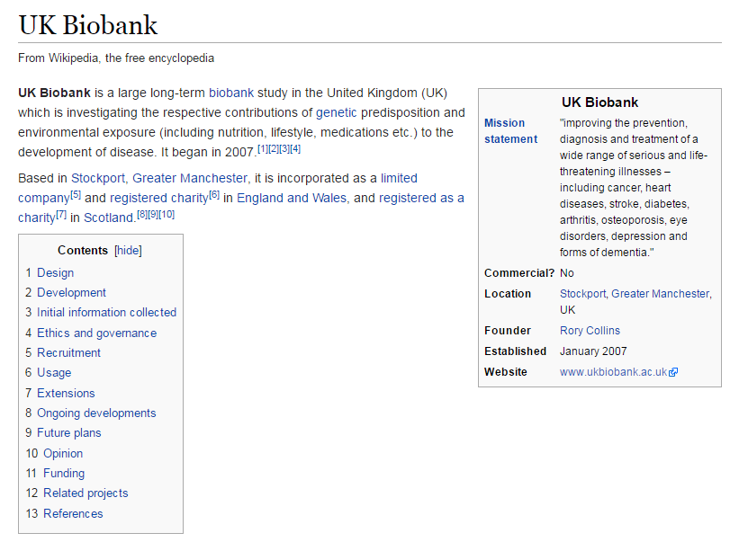


Slide 8
The All of Us Research Program
The cornerstone of the larger PMI – led by the NIH
One million or more volunteers, reﬂecting the broad diversity of the U.S.
Opportunities for volunteers to provide data on an ongoing basis
Data will inform a variety of research studies
Notes:
The All of Us Research Program is a landmark longitudinal research effort that aims to engage one million or more U.S. participants to improve our ability to prevent and treat disease based on individual differences.
(Note: Our official name is the “All of Us Research Program.” Our name is NOT “All of Us: PMI” – the PMI in our logo is intended to indicate our locus as part of the larger federal initiative.)

Slide 9

Two Methods of Engagement
DIRECT VOLUNTEERS
HEALTH CARE PROVIDER ORGANIZATIONS
Notes:
People may engage with the program in these ways:
1. Directly, through a website or smartphone app
(Note: We’ll also have a Support Center to field people’s questions via a toll-free number, chat, or email.)
2. Through a participating health care provider organization (HPO)

Slide 10
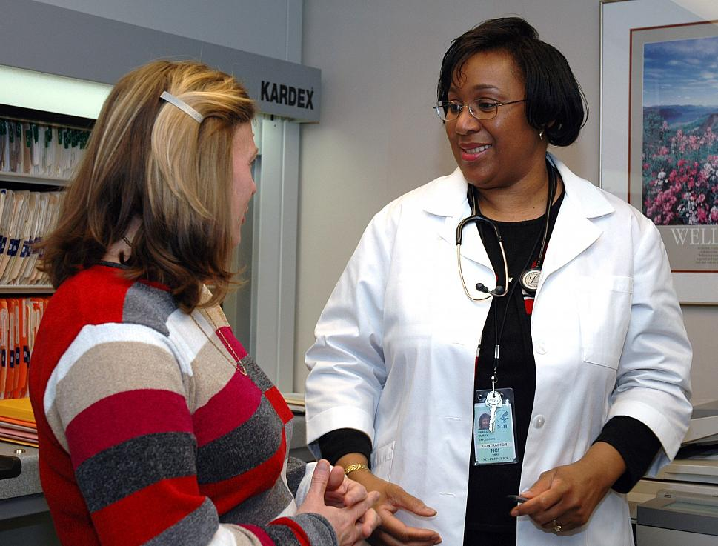
All of Us Research Program Data
The program will start by collecting a limited set of standardized data from sources that will include:
  Participant surveys
  Electronic health records
  Physical measurements
  Biosamples (blood and urine samples)
  Mobile/wearable technologies
  Geospatial/environmental data
Data types will grow and evolve with science, technology, and trust.

Slide 11
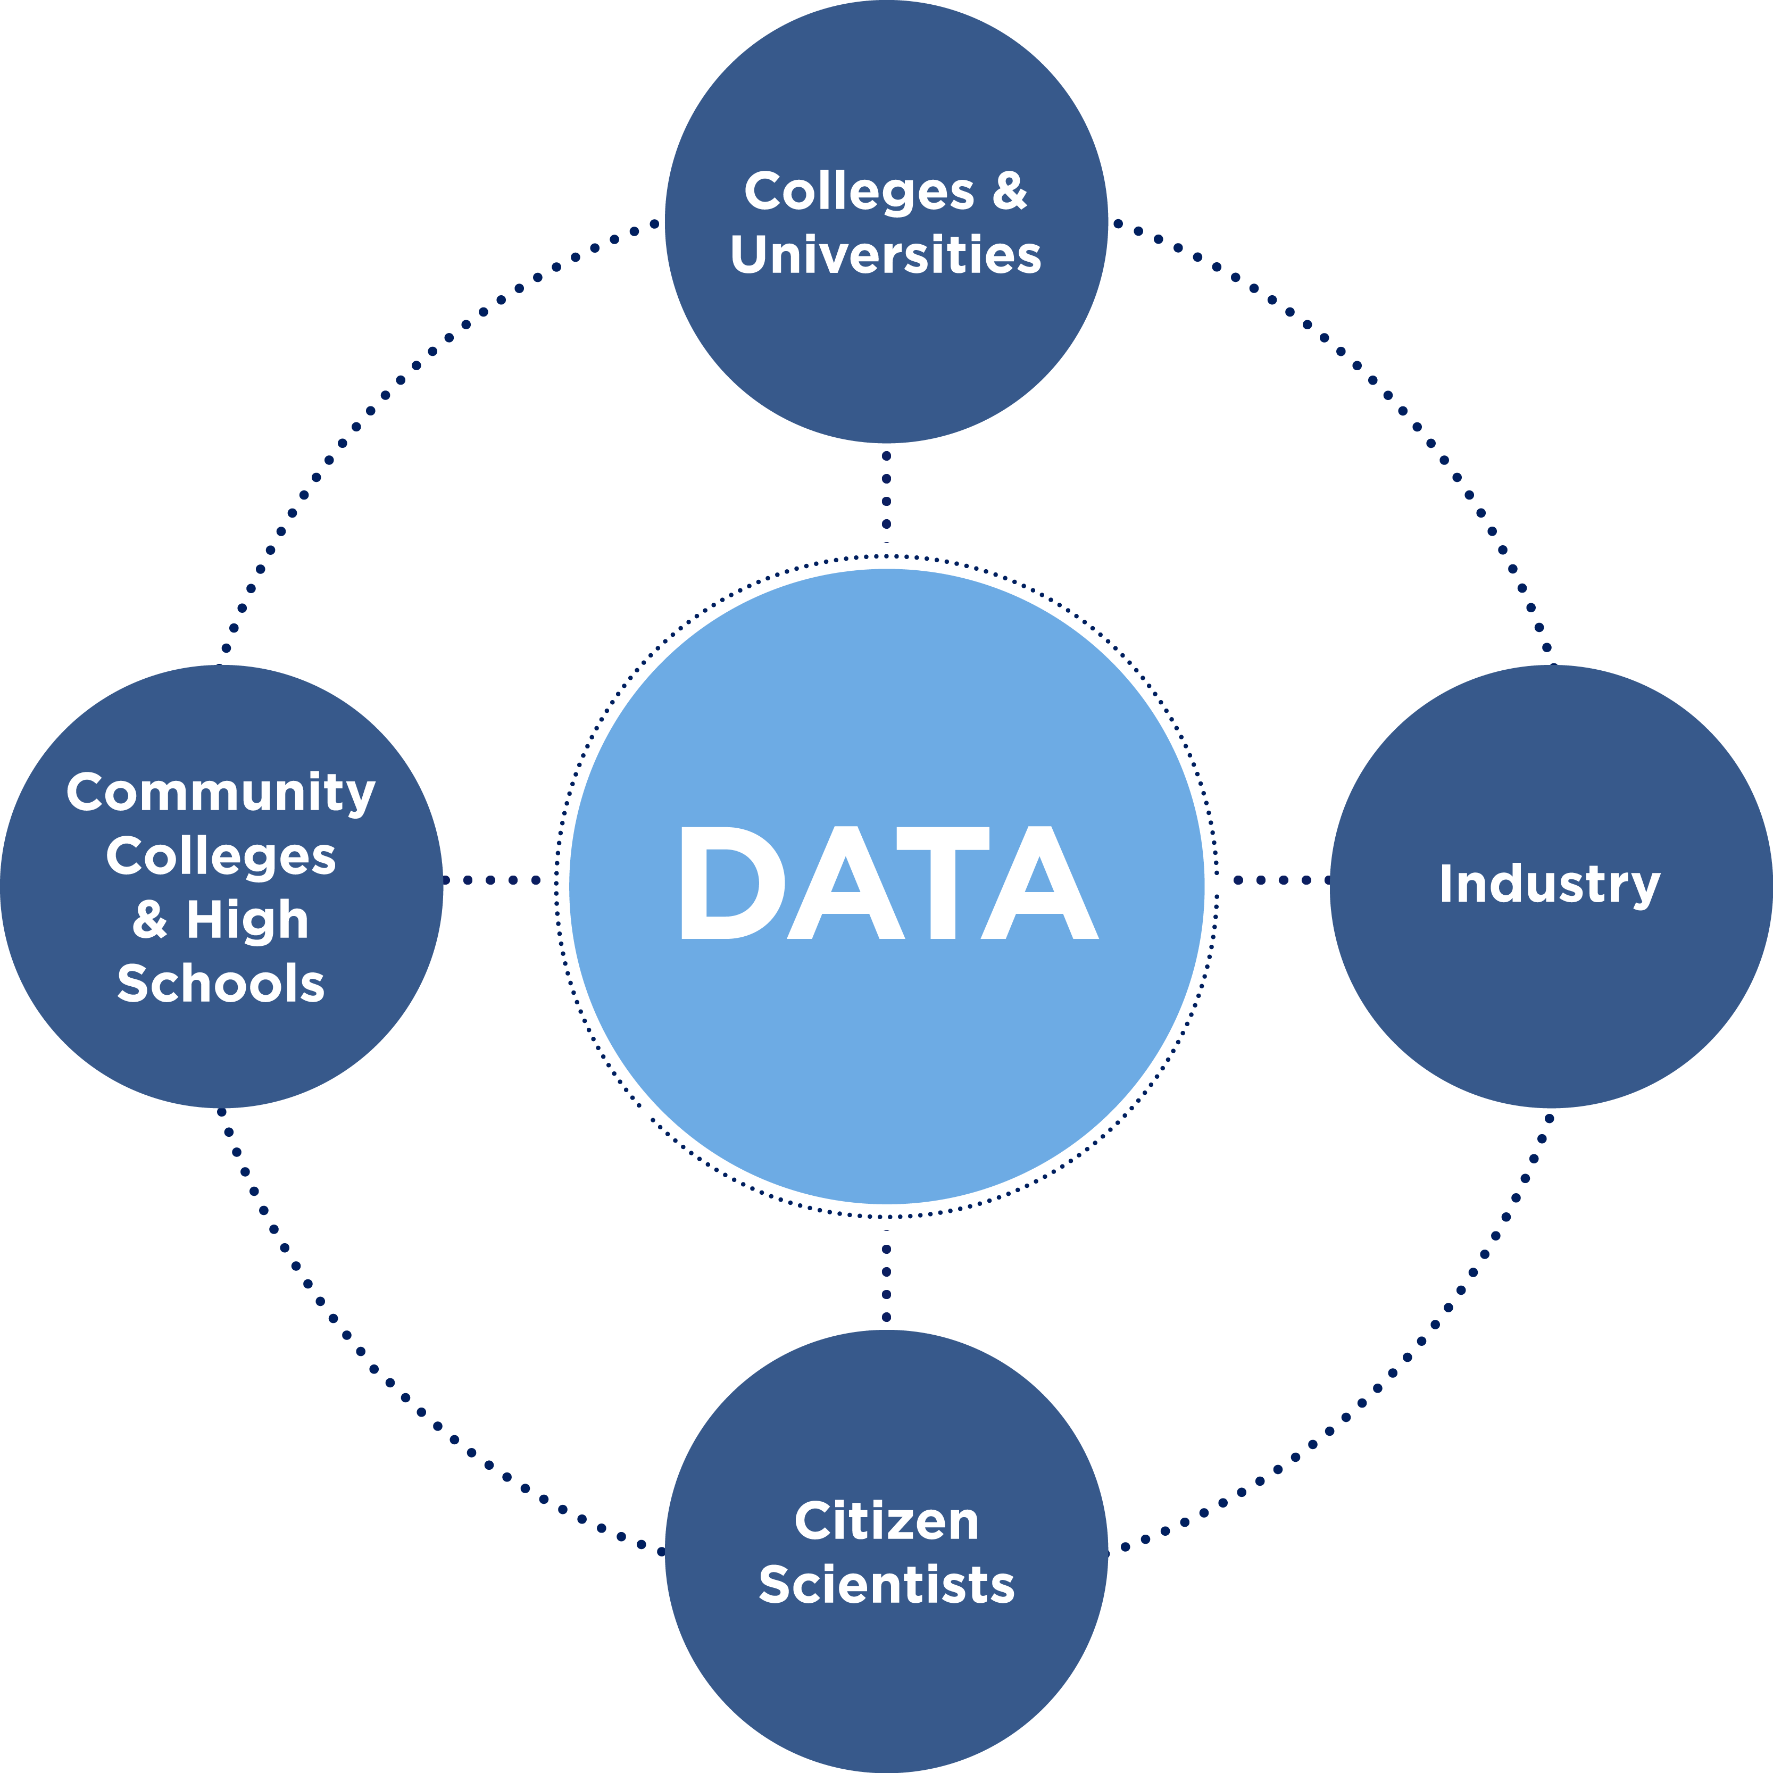
A New Approach to Data Access
Data sharing will be a priority to both researchers and participants
Participants will have access to study information and data about themselves
Data collection will start small and will grow over time
Privacy and security will adhere to the highest standards
NIH will invest to level the playing field so diverse researchers can play

Slide 12
Program Infrastructure
DATA AND RESEARCH
CENTER (DRC)
Big data capture, cleaning, curation,
& sharing in secure environment
Vanderbilt, Verily, Broad Institute
BIOBANK
Repository for processing, storing,
& sharing biosamples (35+M vials)
Mayo Clinic
PARTICIPANT CENTER
Direct volunteer participant enrollment,
digital engagement innovation, &
consumer health technologies
Scripps Research Institute
(with multiple partners)
PARTICIPANT
TECHNOLOGY
SYSTEMS CENTER
Website & mobile apps for
participants
Vibrent Health
HEALTH CARE
PROVIDER ORGS (HPOs)
Clinical & scientific expertise network,
enrollment & retention of participants
20+ regional med centers, FQHCs, VA,
future awards to grow network
COMMUNICATIONS &
ENGAGEMENT
Comms, marketing, & design expertise;
engagement coordination & community
partners network
Wondros, HCM, and
growing network of community partners

Slide 13
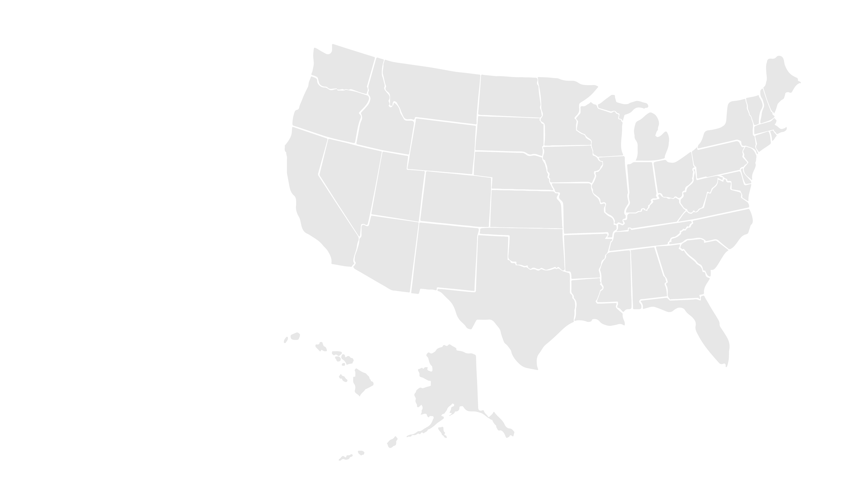





National Network of Inaugural Partners
National Partners
Trans-American Precision Medicine Consortium
Mayo Clinic
(Biobank)
Hudson River Health Care
Community Health Center, Inc.
Regional Medical Centers
New England Precision Medicine Consortium
San Francisco General Hospital Foundation
All of Us, Wisconsin
New York City Precision Medicine Consortium
FQHCs
Illinois Precision Medicine Consortium
University of Pittsburgh
Wondros
Federal Partners:
White House, HHS, NIH, ONC, HRSA, VA, USDS
HCM
Vanderbilt Univ. Medical Center, with Broad & Verily
(Data and Research Center)
Community Partners
Scripps Translational Science Institute
(Participant Center)
Cherokee Health Systems
Eau Claire Cooperative Health Center
Vibrent
(Participant Technology Systems Center)
University of Arizona
(w/Banner Health)
Southern All of Us Network
California Precision Medicine Consortium
Jackson-Hinds Comprehensive Health Center
FiftyForward
National Alliance for Hispanic Health
San Ysidro Health Center
SouthEast Enrollment Center
Delta Research and Educational Foundation

Slide 14

Audacious Goals
Through the All of Us Research Program, we aim to generate:
A new model of research based on collaboration among researchers, providers, and participants
A rich resource of data, including biospecimens, to help accelerate research advances
Increased knowledge leading to individualized care and improved health for future generations

